Slide 1
Wave Interference
y axis
x axis
When two waves occur in sync with each other, constructive interference occurs causing the amplitude to increase.

Slide 2
Wave Interference
y axis
x axis
When two waves occur out of sync with each other, destructive interference occurs causing the amplitude to decrease.

Slide 3
Electromagnetic radiation, EMR
Defined as a form of energy that consists of perpendicular electrical and magnetic fields that change, at the same time and in phase, with time.
The SI unit of frequency is the hertz, Hz
1 Hz = 1 s⁻¹
Wavelength and frequency are related
ν λ = c
c is the speed of light, 2.998 x10⁸ m/s

Slide 4
Electromagnetic radiation
Electromagnetic radiation (EMR) and matter
Transmission - EMR will pass through matter -- no interaction.
Absorption - EMR is absorbed by an atom, ion or molecule, taking it to a higher energy state.
Emission - the release of energy by an atom, ion or molecule as light, taking it to a lower energy state.

Slide 5
Photoelectric Effect
Einstein successfully explained the photoelectric effect
Light is composed of packets of energy quantum called photons.
Each photon carries a specific energy related to its wavelength
  photons of short wavelength (blue light) carry more energy than long wavelength (red light) photons.
The energy of the photon determines if electricity flows
  Not the amount of light

Slide 6
Photoelectric effect
Studies of this effect led to the discovery that light existed as small particles of electromagnetic radiation called photons.
The energy of a photon is directly proportional to the frequency.
Photon energy, E = h ν
h - Planck’s constant, 6.626 x 10⁻³⁴ J . S / photon
Therefore, the energy must be inversely proportional to the wavelength.
Photon energy = h c
λ

Slide 7
Photon energy example
Determine the energy, in kJ/mol of a photon of blue-green light with a wavelength of 486nm.
energy of a photon =
=
= 4.09 x 10⁻¹⁹ J / photon
h c
λ
(6.626 x 10⁻³⁴ J.s)(2.998 x 10⁸ m.s⁻¹)
(4.86 x 10⁻⁷ m)

Slide 8
Photon energy example
We now need to determine the energy for a mole of photons (6.02 x 10²³)
Energy for a mole of photons.
= (4.09 x 10⁻¹⁹ J / photon) (6.02 x 10²³ photons/mol)
= 246 000 J/mol
Finally, convert to kJ
= ( 244 000 J/mol )
= 244 kJ / mol
1 kJ
10³ J

Slide 9
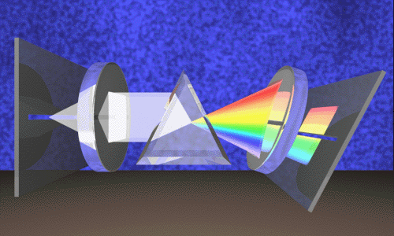
Energy Changes in Atoms
‘White’ light is actually a blend of all visible wavelengths. They can separated using a prism.

Slide 10
Bohr model of the atom
Bohr proposed a model of how electrons moved around the nucleus.
He wanted to explain why electrons did not fall in to the nucleus.
He also wanted to account for spectral lines being observed.
He proposed that the energy of the electron was quantized - only occurred as specific energy levels.

Slide 11
Bohr model of the atom
The Bohr model is a ‘planetary’ type model.
The nucleus is at the center of the model.
Electrons can only exist at specific energy levels (orbit).
Each energy level was assigned a principal quantum number, n.
Each principal quantum
represents a new ‘orbit’ or layer.

Slide 12
Bohr Model
E = -2.178x 10⁻¹⁸ x Z² n²
  Z = nuclear charge
  N = energy level of the electron
  -2.178x 10⁻¹⁸ = proportionality constant

Slide 13
Bohr model of the atom
Bohr derived an equation that determined the energy of each allowed orbit for the electron in the hydrogen atom.
n is the principle quantum number
When electrons gain energy, they jump to a higher energy level which is farther from the nucleus.
Energy is released when the electrons drops down to a lower energy level closer to the nucleus.

Slide 14
Bohr model of the atom
n=5 -52 kJ
n=4 -82 kJ
n=3 -146 kJ
n=2 -328 kJ
n=1 -1312kJ

Slide 15
Bohr model of the atom
Bohr was able to use his model hydrogen to:
Account for the observed spectral lines.
Calculate the radius for hydrogen atoms.
His model did not account for:
Atoms other than hydrogen. Why not?
  Degenerate state? Ask me after we do quantum model!
  Shielding?
Why energy was quantized.
His concept of electrons moving in fixed orbits was later abandoned.

Slide 16
Wave theory of the electron
1924 De Broglie suggested that electrons have wave properties to account for why their energy was quantized.
He reasoned that the electron in the hydrogen atom was fixed in the space around the nucleus.
He felt that the electron would best be represented as a standing wave.
As a standing wave, each electron’s path must equal a whole number times the wavelength.

Slide 17
De Broglie waves
Using de Broglie’s equation, we can calculate the wavelength of an electron.
6.6 x 10⁻³⁴ kg m² s⁻¹
(9.1 x 10⁻³¹ kg)(2.2 x 10⁶ m s⁻¹)
λ =
= 3.3 x 10⁻¹⁰ m
The speed of an electron had already been reported by Bohr as 2.2 x 10⁶ m s⁻¹.

Slide 18
Heisenberg uncertainty principle
In order to observe an electron, one would need to hit it with photons having a very short wavelength and high frequency.
If one were to hit an electron, it would cause the motion and the speed of the electron to change.
Lower energy photons would have a smaller effect but would not give precise information.

Slide 19
Heisenberg uncertainty principle
According to Heisenberg, it is impossible to know both the position and the speed of an object precisely.
He developed the following relationship:
∆x ∆(mv)
As the mass of an object gets smaller, the product of the uncertainty of its position (∆x) and speed (∆v) increase.
h
4 π m
>

Slide 20
Quantum model of the atom
Schrödinger developed an equation to describe the behavior and energies of electrons in atoms.
His equation is used to plot the position of the electron relative to the nucleus as a function of time.
While the equation is too complicated to write here, we can still use the results.
Each electron can be described in terms of its quantum numbers.

Slide 21
Quantum numbers
Principal quantum number, n
Tells the size of an orbital and largely determines its energy.
n = 1, 2, 3, ……
Orbital (azimuthal or angular momentum) quantum number, l
The number of subshells that a principal level contains. It tells the shape of the orbitals.
l = 0 to n - 1

Slide 22
Magnetic Quantum Number (m_{l})
The magnetic quantum number describes the three-dimensional orientation of the orbital.
Allowed values of m_{l} are integers ranging from –l to +l:
Therefore, on any given energy level, there can be up to 1 s orbital, 3 p orbitals, 5 d orbitals, 7 f orbitals, etc.

Slide 23
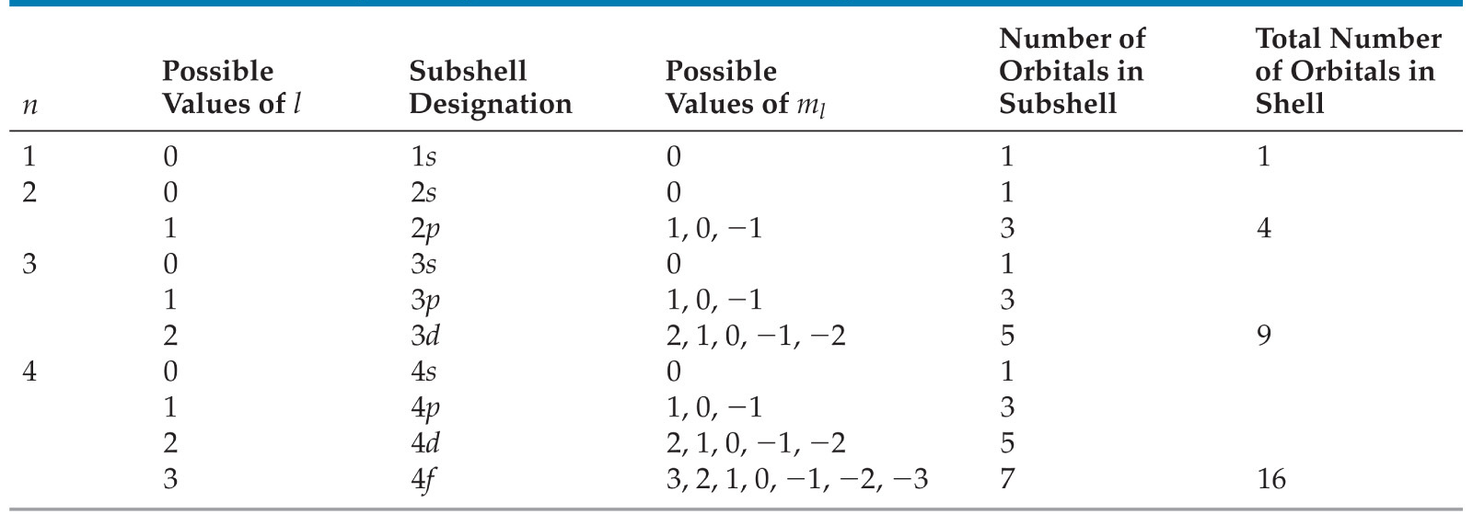
Magnetic Quantum Number (m_{l})
Orbitals with the same value of n form a shell.
Different orbital types within a shell are subshells.

Slide 24
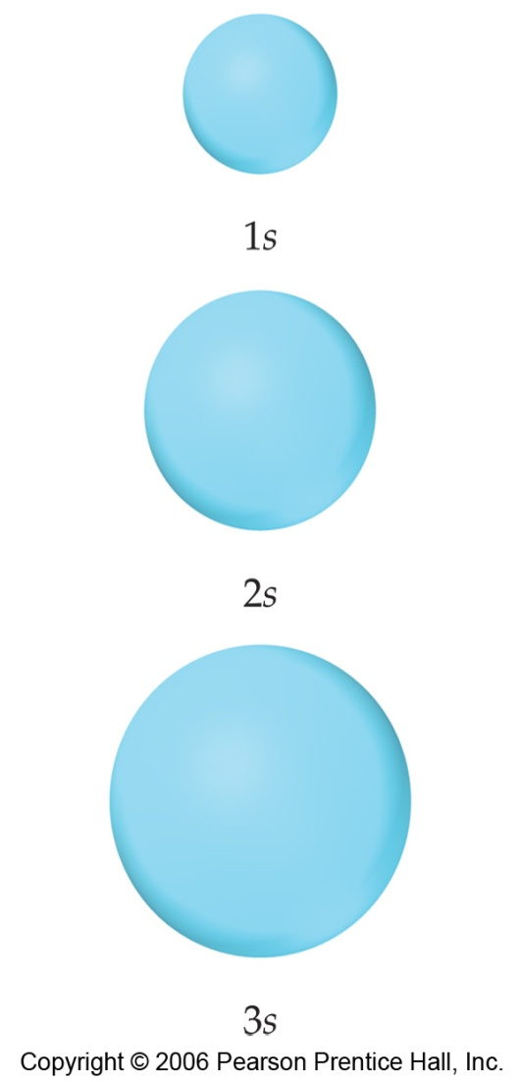
s Orbitals
The value of l for s orbitals is 0.
They are spherical in shape.
The radius of the sphere increases with the value of n.

Slide 25
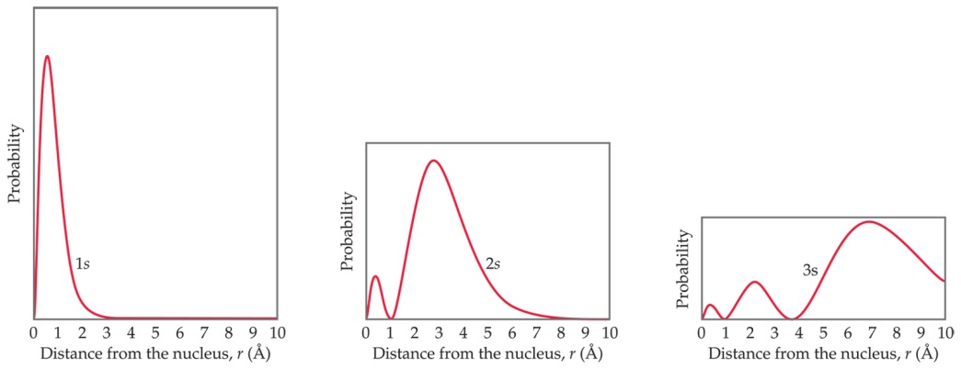
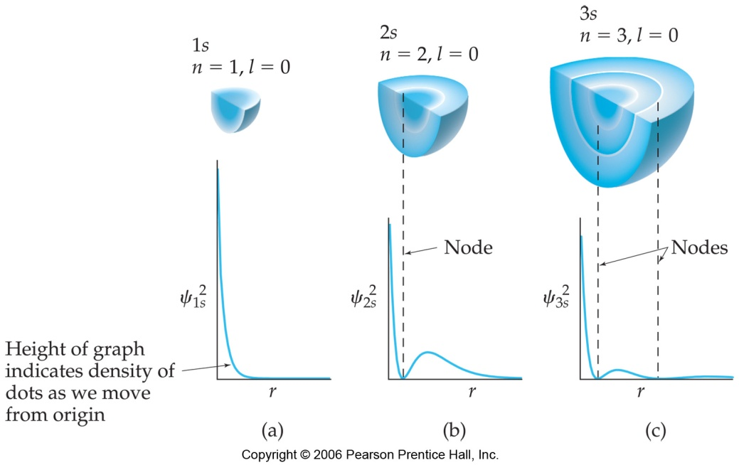
s Orbitals
Observing a graph of probabilities of finding an electron versus distance from the nucleus, we see that s orbitals possess n-1 nodes, or regions where there is 0 probability of finding an electron.

Slide 26
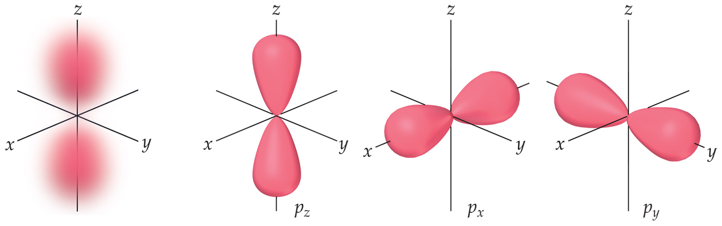
p Orbitals
The value of l for p orbitals is 1.
They have two lobes with a node between them.

Slide 27
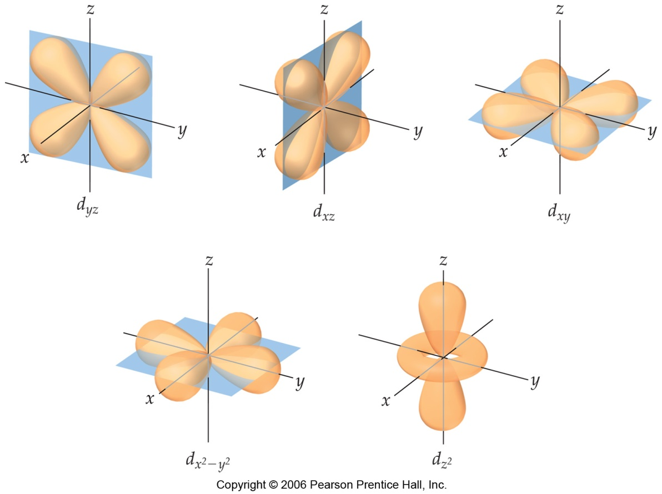
d Orbitals
The value of l for a d orbital is 2.
Four of the five d orbitals have 4 lobes; the other resembles a p orbital with a doughnut around the center.

Slide 28
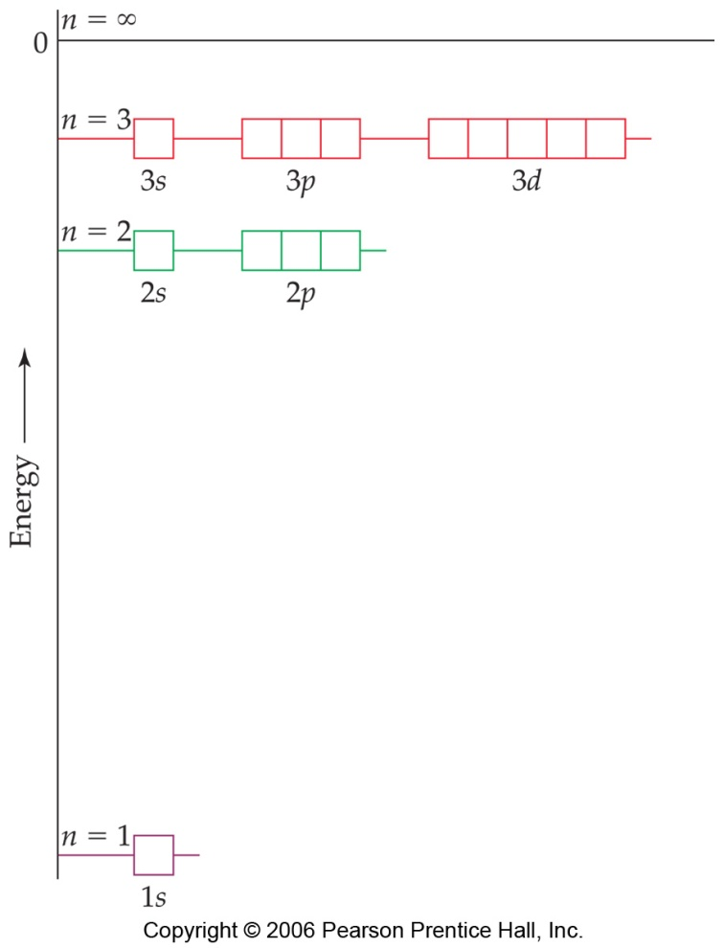
Energies of Orbitals
For a one-electron hydrogen atom, orbitals on the same energy level have the same energy.
That is, they are degenerate.

Slide 29
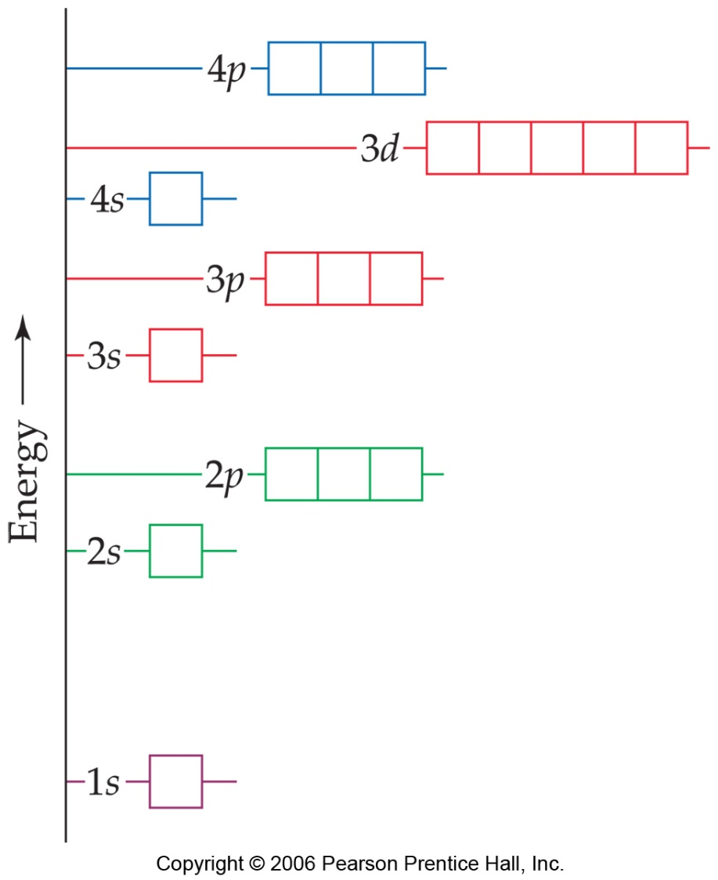
Energies of Orbitals
As the number of electrons increases, though, so does the repulsion between them.
Therefore, in many-electron atoms, orbitals on the same energy level are no longer degenerate.

Slide 30
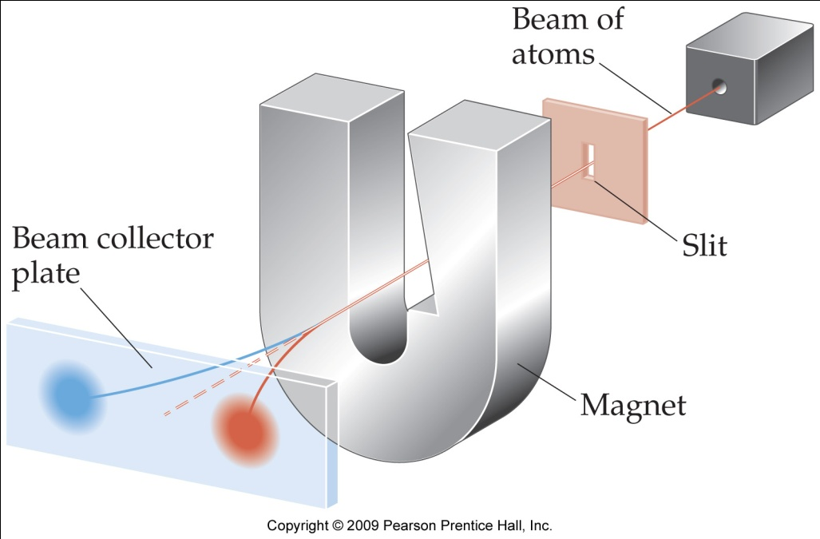
Spin Quantum Number, m_{s}
In the 1920s, it was discovered that two electrons in the same orbital do not have exactly the same energy.
The “spin” of an electron describes its magnetic field, which affects its energy.

Slide 31
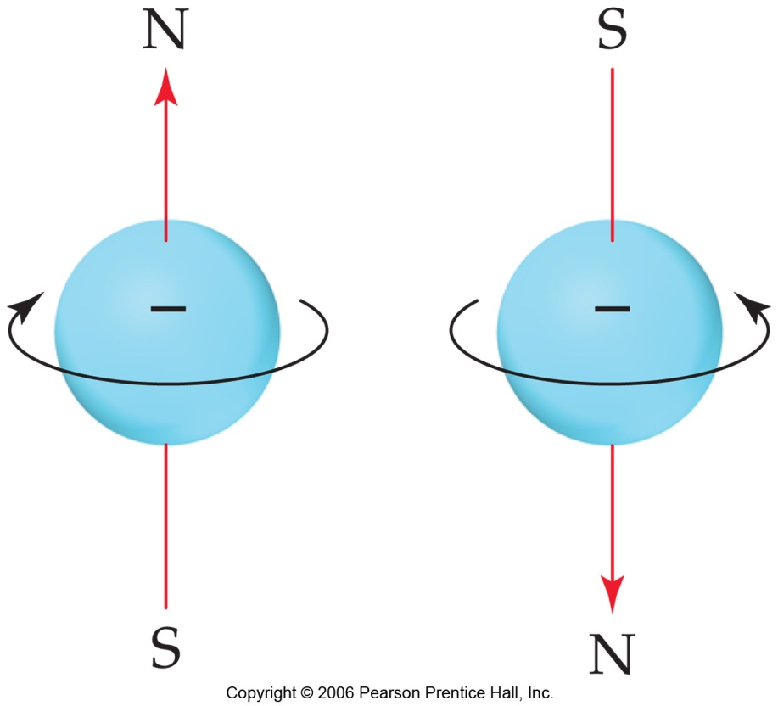
Spin Quantum Number, m_{s}
This led to a fourth quantum number, the spin quantum number, m_{s.}
The spin quantum number only has 2 allowed values: +1/2 and -1/2.

Slide 32
Pauli Exclusion Principle
No two electrons in the same atom can have exactly the same energy.
Therefore, no two electrons in the same atom can have identical sets of quantum numbers.

Slide 33
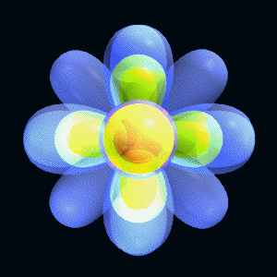
Combined orbitals - n = 1, 2 & 3
1s, 2s, 2p, 3s, 3p and 3d sublevels

Slide 34


Representative f orbitals
There are seven f orbitals
(4 have the eight-lobe shape)
http://www.uky.edu/~holler/html/orbitals_2.html

Slide 35
Quantum numbers
Magnetic quantum number, m
Describes the orientation that the orbital has in space, relative to an x, y, z plot.
m = -  to +  (all integers, including zero)
For example, if  = 1, then m would have values of -1, 0, and +1.
Knowing all three numbers provide us with a picture of all of the orbitals.

Slide 36
Electron configuration
Things get a bit more complex where more than one electron is involved.
Effective nuclear charge(kernel charge)
Inner electrons act to shield outer ones from the positive charge of the nucleus.
Some orbitals penetrate to the nucleus more than others: s > p > d > f

Slide 37
Aufbau(building) approach
We can use this approach to ‘build’ atoms and describe their electron configurations.
For any element, you know the number of electrons in the neutral atom equals the atomic number. For an ion, the number of electrons equals the number of protons minus the charge.
Start filling orbitals, from lowest to highest energy.
If two or more orbitals exist at the same energy sublevel, do not pair the electrons until you first have one electron per orbital.

Slide 38
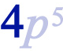
Electron Configurations
This shows the distribution of all electrons in an atom.
Each component consists of
  A number denoting the energy level;

Slide 39
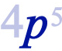
Electron Configurations
This shows the distribution of all electrons in an atom.
Each component consists of
  A number denoting the energy level,
  A letter denoting the type of orbital,

Slide 40
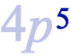
Electron Configurations
This shows the distribution of all electrons in an atom.
Each component consists of
  A number denoting the energy level,
  A letter denoting the type of orbital,
  A superscript denoting the number of electrons in those orbitals.

Slide 41
Major trends in
electron filling
1s²
2s²
2p⁶
3s²
3p⁶
3d¹⁰
Blue sublevels
not occupied…
Not enough e-
4s²
4p⁶
4d¹⁰
4f¹⁴
5s²
5p⁶
5d¹⁰
5f¹⁴
5g¹⁸
6s²
6p⁶
6d¹⁰
6f¹⁴
6g¹⁸
6h²²
7s²
7p⁶
7d¹⁰
7f¹⁴
7g¹⁸
7h²²
7i²⁶

Slide 42
Writing electron configurations
Examples
O 1s ² 2s ² 2p ⁴
Ti 1s ² 2s ² 2p ⁶ 3s ² 3p ⁶ 4s ² 3d ²
Br 1s ² 2s ² 2p ⁶ 3s ² 3p ⁶ 4s ² 3d ¹⁰ 4p ⁵
Core format
O [He] 2s ² 2p ⁴
Ti [Ar] 4s ² 3d ²
Br [Ar] 4s ² 3d ¹⁰ 4p ⁵

Slide 43
Classification by sublevels
s
p
H
He
d
Li
Be
B
C
N
O
F
Ne
Na
Mg
Al
Si
P
S
Cl
Ar
K
Ca
Sc
Ti
V
Cr
Mn
Fe
Co
Ni
Cu
Zn
Ga
Ge
As
Se
Br
Kr
Rb
Sr
Y
Zr
Nb
Mo
Tc
Ru
Rh
Pd
Ag
Cd
In
Sn
Sb
Te
I
Xe
Cs
Ba
Lu
Hf
Ta
W
Re
Os
Ir
Pt
Au
Hg
Tl
Pb
Bi
Po
At
Rn
Fr
Ra
Lr
La
Ce
Pr
Nd
Pm
Sm
Eu
Gd
Tb
Dy
Ho
Er
Tm
Yb
f
Ac
Th
Pa
U
Np
Pu
Am
Cm
Bk
Cf
Es
Fm
Md
No

Slide 44
Aufbau examples
2p
2p
2p
2s
2s
2s
energy
1s
1s
1s
C O F

Slide 45
Writing electron configurations
Electron configurations can be written for atoms or ions.
Start with the ground-state configuration for the atom.
For positively-charged cations, remove a number of the outermost electrons equal to the charge.
For negatively-charged anions, add a number of outermost electrons equal to the charge.

Slide 46
Writing electron configurations
Example - Cl⁻
First, write the electron configuration for chlorine:
Cl 17 e⁻
1s ² 2s ² 2p ⁶ 3s ² 3p ⁵ or [Ne] 3s ² 3p ⁵
Because the charge is 1-, add one electron.
Cl⁻ 1s ² 2s ² 2p ⁶ 3s ² 3p ⁶
or [Ne] 3s ² 3p ⁶ or [Ar]

Slide 47
Writing electron configurations
Example - Ba²⁺
First, write the electron configuration for barium.
Ba 56 e⁻
1s² 2s² 2p⁶ 3s² 3p⁶ 4s² 3d¹⁰ 4p⁶ 5s² 4d¹⁰ 5p⁶ 6s²
or [Xe] 6s²
Because the charge is 2+, remove two electrons.
Ba²⁺
1s² 2s² 2p⁶ 3s² 3p⁶ 4s² 3d¹⁰ 4p⁶ 5s² 4d¹⁰ 5p⁶
or [Xe] or [Kr] 5s² 4d¹⁰ 5p⁶

Slide 48
Hund’s Rule
When putting electrons into orbitals with the same energy, place one electron in each orbital before pairing them up. The lone electrons will have the same direction of spin.
The existence of
unpaired electrons
can be tested for
since each acts like
a tiny electromagnet.

Slide 49
Hund’s Rule
Magnetism results from unpaired electrons in the ground state.
Paramagnetic - attracted to magnetic field. Indicates the presence of unpaired electrons. Temporary!
Diamagnetic - unaffected by a magnetic field. Indicates that all electrons are paired.
Ferromagnet - When there are multiple unpaired electrons (like in iron), this results in a permanent magnet

Slide 50
Orbital Notation
A simple method used to show only the electrons in the highest main energy level. The d and f sublevels are not shown unless they are partially filled.
Indicates which orbitals are occupied and whether or not electrons are paired with other electrons in the orbitals.

Slide 51
Orbital Notation
For O, 1s² 2s² 2p⁴ , the orbital notation is
2s 2p
  O
Notice that the electrons do not pair up in orbitals of the same energy sublevel until each of the orbitals is occupied by a single electron, all spinning the same direction. (Hund’s Rule)

Slide 52
Orbital Notation
For V, 1s² 2s² 2p⁶ 3s² 3p⁶ 4s² 3d³ , the orbital notation is
4s 3d
  V
Notice that there must be five d orbitals shown, even though two of the orbitals are empty.

Slide 53
Irregularities in electron configurations
There are several elements that have actual electron configurations that are different from those predicted.
The predicted electron configuration for Cu is
1s² 2s² 2p⁶ 3s² 3p⁶ 4s² 3d⁹ , however the actual
configuration is 1s² 2s² 2p⁶ 3s² 3p⁶ 4s¹ 3d¹⁰
The filled 3d sublevel has less energy than the filled 4s sublevel.
4s 3d
  Cu

Slide 54
Irregularities in electron configurations
Other elements follow a similar pattern, such as silver and gold.
Ag 47 e⁻ [Kr] 5s¹ 4d¹⁰
Au 79 e⁻ [Xe] 6s¹ 4f¹⁴ 5d¹⁰
The predicted electron configuration for Cr is
1s² 2s² 2p⁶ 3s² 3p⁶ 4s² 3d⁴ , however the actual
configuration is 1s² 2s² 2p⁶ 3s² 3p⁶ 4s¹ 3d⁵
4s 3d
  Cr

Slide 55
Atomic Structure & Periodic Properties
What factors of atomic structure effect the properties of the elements?

Slide 56
Atomic Structure & Periodic Properties
Factor 1: Number of valence (outershell) electrons
The valence electrons are those in the highest numbered energy level that are used for chemical reactions.
An element will try to gain, lose or share electrons to get a structure similar to the inert gases.

Slide 57
Atomic Structure & Periodic Properties
Factor 2: Number of main energy levels (shells)
The more shells of electrons an atom has, the farther the valence electrons are from the nucleus.
With each additional shell, the valence electrons are more shielded from the attraction of the nucleus and are held less tightly.

Slide 58
Atomic Structure & Periodic Properties
Factor 3: The net nuclear force (a.k.a. kernel charge)
The net nuclear force is equal to the difference between the protons and the inner shell electrons.
It is a measure of the relative pulling power of the nucleus for the valence electrons.
For atoms, the kernel charge equals the Group A number.

Slide 59
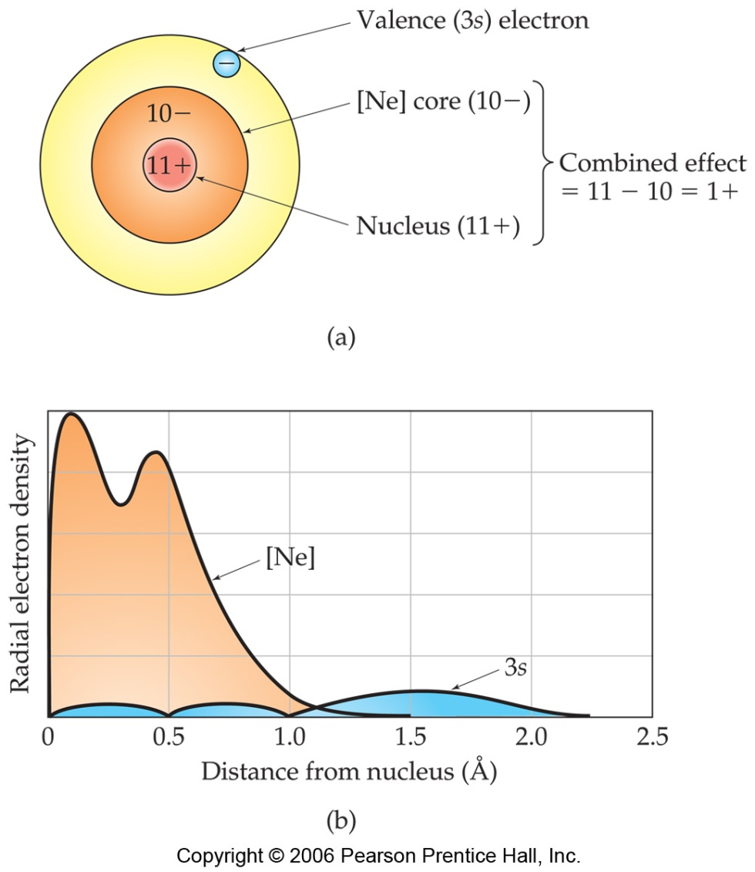
Effective Nuclear Charge
In a many-electron atom, electrons are both attracted to the nucleus and repelled by other electrons.
The nuclear charge that an electron experiences depends on both factors.

Slide 60
Effective Nuclear Charge
The effective nuclear charge, Z_{eff,} is found this way:
  Z_{eff} = Z – S
Where Z is the atomic number and S is a screening constant, usually close to the number of inner electrons. (Assume this, don’t count valence electrons)

Slide 61
Alkali Metals
Li
1s²2s¹
valence e⁻
Na
kernel charge =
3p-2 inner e⁻ = +1
1s²2s²2p⁶3s¹
valence e⁻
KC =11p-10 inner e⁻ = +1
K
1s²2s²2p⁶3s²3p⁶4s¹
KC =19p-18 inner e⁻ = +1
valence e⁻

Slide 62
Periodic trends
Many trends in physical and chemical properties can be explained by electron configuration and atomic structure.
We’ll look at some of the more important examples.
Metal vs. Nonmetal reactivity
Atomic radii vs. Ionic radii
Ionization energies
Electron affinities
Electronegativity

Slide 63
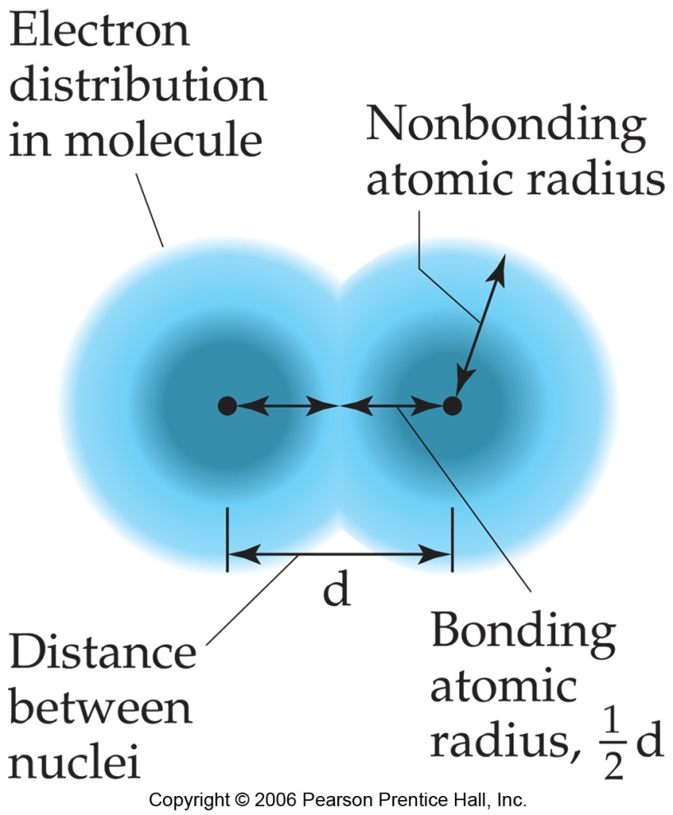
What Is the Size of an Atom?
The bonding atomic radius is defined as one-half of the distance between bonded nuclei.
This is how we measure atomic radius.

Slide 64
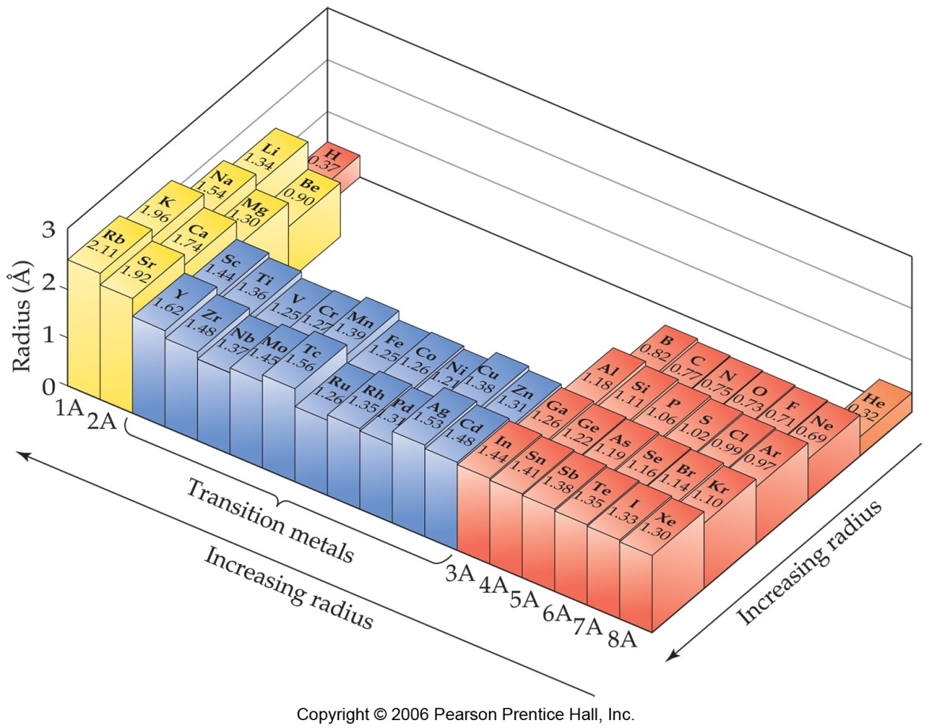
Sizes of Atoms
Atomic radius tends to…
  …decrease from left to right across a row
    due to increasing Z_{eff}
  …increase from top to bottom of a column
    due to increasing value of n

Slide 65
Atomic radii
Radus (pm)
Atomic number
(noble gases are not included)

Slide 66
Isoelectronic configurations
Species that have the same electron configurations.
Example
Each of the following has an e⁻ configuration of 1s² 2s² 2p⁶
O²⁻ F⁻ Ne
Na⁺ Mg²⁺ Al³⁺

Slide 67
Atomic radii of the main group elements
Atoms get larger as you go down a group (vertical column).
A new shell is being added, but the kernel charge remains the same.
Atoms get smaller as you go across a period (horizontal row).
The nucleus contains more protons with the same number of inner shell electrons.
Which results in a higher kernel charge that attracts the same number of electron shells more strongly, making the atom smaller.

Slide 68
Ionic radii (pm = 10⁻¹² m)
Li Li⁺ Be Be²⁺ N N³⁻ O O²⁻ F F⁻
152 74 111 35 70 171 66 140 64 136
Na Na⁺ Mg Mg²⁺ P P³⁻ S S²⁻ Cl Cl⁻
186 102 160 72 110 212 104 184 99 181
K K⁺ Ca Ca²⁺ As As³⁻ Se Se²⁻ Br Br ⁻
227 138 197 100 121 222 117 198 114 195
Rb Rb⁺ Sr Sr²⁺ Te Te²⁻ I I⁻
248 149 215 116 137 221 133 216
Cs Cs⁺ Ba Ba²⁺
265 170 217 136
atoms shown in blue

Slide 69
Ionization energy(IE)
First ionization energy
The energy to remove one electron from a neutral atom in the gas phase.
A(g) + first ionization energy A⁺(g) + e⁻
The higher the ionization energy, the stronger the attraction between the net nuclear force and the valence shell. This indicates how easy it is to form a cation.
Metals tend to have lower first ionization energies than nonmetals.

Slide 70
First ionization energy
In general, ionization energy increases when going towards the upper right side of the periodic table, but there are exceptions.
H
Li
Be
B
C
N
O
F
Na
Mg
Al
Si
P
S
Cl
K
Ca
Ga
Ge
As
Se
Br
Rb
Sr
In
Sn
Sb
Te
I
Cs
Ba
Tl
Pb
Bi
Po
At

Slide 71
First ionization energy
He 1s²
Notice how the ionization energies are greater for those elements with filled s, p and d sublevels and half-filled p and d sublevels.
Ne 2p⁶
Ar 3p⁶
2p³
Kr 4p⁶
First ionization energy (kJ/mol)
Xe 5p⁶
3p³
Rn 6p⁶
4p³
5d¹⁰
2s²
3d¹⁰
4d¹⁰
3s²
4f¹⁴
6p³
Atomic number

Slide 72
Ionization energy
Stability of filled and half-filled sublevels
When all of the orbitals of a sublevel are filled (or when p, d and f sublevels are half-filled), the electron charge distribution is more stable.
Therefore, more energy is required to remove an electron and the ionization energy is greater than expected, based upon the kernel charge and number of shells.

Slide 73
Ionization energy
Successive ionization energies
It is possible to remove more than one electron from an atom, but ionization energy increases with each successive electron removed.
The amount of energy needed depends upon the kernel charge and electron structure of the positive ions that form.

Slide 74
Successive Ionization energy (kJ/mole)
H He Li Be B
1312 2372 520 900 801
He⁺ Li⁺ Be⁺ B⁺
Li²⁺ Be²⁺ B²⁺
Be³⁺ B³⁺
B⁴⁺
1st
2nd
5250 7298 1757 2427
*highest value
in blue
3rd
11815 14849 3660
4th
21007 25025
5th
32827

Slide 75
Electron affinity(EA)
A measure of an atom’s tendency to gain electrons in the gas phase.
If the atom becomes more stable, then energy is released (exothermic)
A(g) + e⁻ A⁻(g) + thermal energy
If the atom becomes less stable, then energy must be absorbed (endothermic)
A(g) + e⁻ + thermal energy A⁻(g)

Slide 76
Electron affinity
The energy released when an atom gains an e⁻.
H
Li
Be
B
C
N
O
F
Na
Mg
Al
Si
P
S
Cl
K
Ca
Ga
Ge
As
Se
Br
Rb
Sr
In
Sn
Sb
Te
I
Cs
Ba
Tl
Pb
Bi
Po
At
In general, EA increases from left to right as the kernel charge increases, and ……
from bottom to top because there are fewer electron shells allowing the valence electrons ato be closer to the nucleus.

Slide 77
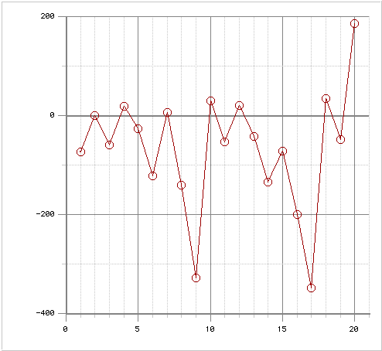
The pattern of varying electron affinity is more irregular, though, as a periodic function of atomic number.
Notice how the elements
with filled and half-filled sublevels have positive EA values.
endothermic
EA = + value
Ca
Ne
Mg
Ar
He
Be
N
P
Na
K
H
Li
Electron affinity (kJ/mol)
F
Cl
exothermic
EA = - value
Atomic number

Slide 78
Electronegativity
The relative ability of an atom to attract electrons to itself when it is bonded to another atom.
It is related to ionization energy and electron affinity.
It cannot be directly measured.
The values are unitless since they are relative to each other.
The values vary slightly from compound to compound but still provide useful qualitative predictions.

Slide 79
Electronegativity
In general, electronegativity increases with increasing kernel charge and fewer electron shells.
H
2.2
Li
1.0
Be
1.5
B
2.0
C
2.5
N
3.1
O
3.5
F
4.1
Na
1.0
Mg
1.2
Al
1.5
Si
1.7
P
2.1
S
2.4
Cl
2.8
K
0.9
Ca
1.0
Ga
1.8
Ge
2.0
As
2.2
Se
2.5
Br
2.7
Rb
0.9
Sr
1.0
In
1.5
Sn
1.7
Sb
1.8
Te
2.0
I
2.2
Cs
0.9
Ba
1.0
Tl
1.4
Pb
1.5
Bi
1.7
Po
1.8
At
1.9

Slide 80
Polar molecules
Electrons in a covalent bond are rarely shared equally.
Unequal sharing results in polar bonds.
∂ indicates partial charge
∂+
∂-
arrow shows direction of electron shift
oo
H Cl
oo
oo
oo
H has smaller electronegativity
Slight positive charge
Cl has larger electronegativity
Slight negative charge

Slide 81
Electronegativity
The greater the difference in electronegativity between two bonded atoms, the more polar the bond.
If the difference is >1.67, electrons are transferred from the less electronegative atom to the more electronegative one to form an ionic bond.
The bond will be completely nonpolar only if the two atoms have exactly the same electronegativity. (If the diff < 0.5, we will consider bond to be nonpolar.)

Slide 82
Properties of ionic & covalent compounds
Ionic compounds
  Held together by electrostatic attraction
  Exist as 3-D network of ions
  Empirical formula is used
Covalent compounds
  Discrete molecular units
  Atoms held together by shared e ⁻ pairs
  Formula represents atoms in a molecule

Slide 83
Electronegativity
Determine the difference in electronegativity between the bonded atoms in the following compounds.
KCl
H₂O
CH₄
NO₂
EN_{K} = 0.82 EN_{Cl} = 3.16 Diff = 2.34
75% ionic
EN_{H} = 2.20 EN_{o} = 3.44 Diff = 1.24
32% ionic
EN_{C} = 2.55 EN_{H} = 2.20 Diff = 0.35
3% ionic
EN_{N} = 3.04 EN_{O} = 3.44 Diff = 0.40
4% ionic

Slide 84
Chemical properties
& the periodic table
Electron configurations help us understand changes in atomic and ionic radii, ionization energies, electron affinities, electronegativities, and chemical reactivity.

Slide 85
Chemical properties
& the periodic table
Various trends can be observed as you go down a group.
Add extra shells(main energy levels)
Atomic and ionic radii increase.
Ionization energy, electron affinity and electronegativity decrease.

Slide 86
Chemical properties
& the periodic table
Various trends can be observed as you go down a group.
Main group metals become more reactive.
Nonmetals become less reactive
Transition metals become slightly less reactive.

Slide 87
Chemical properties
& the periodic table
Various trends can be observed as you go across a period.
Add extra valence electrons for the main group A elements.
Increase the kernel charge for the main group A elements.
Most transition metals have 2 valence electrons and +2 kernel charge.

Slide 88
Chemical properties
& the periodic table
Various trends can be observed as you go across a period.
Atomic radii decrease for the main group A elements.
The size of transition metals remains fairly constant. (The extra protons overcompensate for the extra inner shell electrons to have slightly stronger pull.)
Positive ions decrease in size.
Negative ions increase in size.

Slide 89
Chemical properties
& the periodic table
Various trends can be observed as you go across a period.
In general, ionization energy, electron affinity, and electronegativity increases.
Elements with filled or half-filled sublevels are unusually stable.
Metals lose electrons and nonmetals gain electrons.

Slide 90
Lewis Electron-Dot Diagrams
Basic rules
  Draw the atomic symbol.
  Treat each side as an orbital that can hold up to two electrons.
  Count the electrons in the valence shell.
  Start filling the boxes, as you would the orbitals.
p_{x}
X
p_{y}
s
p_{z}

Slide 91
Lewis symbols
Note: The position of the pairs of electrons is not important.
p_{x}
O
p_{y}
s
Oxygen has 6 electrons
in its valence - VIA.
Start putting them in
the boxes.
p_{z}

Slide 92
Lewis symbols
Lewis symbols of second period elements
Li Be B C
N O F Ne

Slide 93
Drawing Lewis structures
Write the electron dot diagrams for each element in the compound.
Check the electronegativity difference between the elements to determine if electrons are transferred or shared.
If the electronegativity difference > 1.67, the reaction forms ions. Remove the electrons from the metal and add them to the nonmetal.

Slide 94
Drawing Lewis Structures
Write the charges of the ions formed and use coefficients to show how many of each ion are needed to balance the overall charge.
+
2-
[ ]
2Na ,
O
Ionic sodium oxide

Slide 95
Drawing Lewis structures
If the electronegativity difference < 1.67, then the atoms will share electrons.
Position shared electron pairs between the two atoms, and connect them with a single line to represent a covalent bond.
Place the extra pairs of electrons around atoms until each has eight
(Exception: For hydrogen or metallic elements use only the valence electrons that are available, so these atoms have less than an octet.)

Slide 96
Drawing Lewis structures
If an atom other than hydrogen or a metal has less than eight electrons, move unshared pairs to form multiple bonds.
Add extra atoms, if needed, to obtain the octets. Atoms with positive oxidation numbers should be bonded to those with negative oxidation numbers.
If extra electrons still remain, add them to the central atom. All oxidation numbers should add up to zero for a compound.

Slide 97
Single covalent bonds
Cl
H
Be
H
C
H
F
F
Cl
H
Do atoms (except H or metals) have octets?

Slide 98
Lewis structures
Example CO₂
Step 1
  Draw any possible structures
C-O-O O-C-O
You may want to use lines for bonds.
Each line represents 2 electrons.

Slide 99
Lewis structures
Step 2
  Determine the total number of valence electrons.
  CO₂ 1 carbon x 4 electrons = 4
        2 oxygen x 6 electrons = 12
        Total electrons = 16

Slide 100
Lewis structures
Step 3
  Try to satisfy the octet rule for each atom
    - all electrons must be in pairs
    - make multiple bonds as required
Try the C-O-O structure
No matter what you
try, there is no way
satisfy the octet for
all of the atoms.
C O O

Slide 101
Lewis structures
This arrangement needs
too many electrons.
O C O
How about making some double bonds?
O=C=O
That works!
= is a double bond,
the same as 4 electrons

Slide 102
Ammonia, NH₃
Step 1
H
Step 2 3 e⁻ from H
5 e⁻ from N
        8 e⁻ total
H N H
Step 3
H
N has octet
H has 2 electrons
(all it can hold)
H N H

Slide 103
Multiple bonds
So how do we know that multiple bonds really exist?
The bond energies and lengths differ!
Bond Bond Length Bond energy
type order pm kJ/mol
C C 1 154 347
C C 2 134 615
C C 3 120 812

Slide 104
Resonance structures
Sometimes we can have two or more equivalent Lewis structures for a molecule.
O - S = O O = S - O
They both - satisfy the octet rule
- have the same number of bonds
- have the same types of bonds
Which is right?

Slide 105
Resonance structures
They both are!
O - S = O O = S - O
O S O
This results in an average of 1.5 bonds between each S and O.

Slide 106
Resonance structures
Benzene, C₆H₆, is another example of a compound for which resonance structures must be written. At each corner of the hexagonal ring, there is a carbon atom with a double bond to one C and a single bond to another C and to an H atom.
All of the bonds are the same length.
or

Slide 107
Exceptions to the octet rule
Not all compounds obey the octet rule.
Three types of exceptions
Species with more than eight electrons around an atom.
Species with fewer than eight electrons around an atom.
Species with an odd total number of electrons.

Slide 108
Atoms with fewer than eight electrons
Beryllium and boron will both form compounds where they have less than 8 electrons around them.
..
..
:
..
:F B F:
:F:
:Cl Be Cl:
..
..
:
..
..

Slide 109
Atoms with fewer than eight electrons
Electron deficient. Species other than hydrogen and helium that have fewer than 8 valence electrons.
They are typically very reactive species.
Coordinate covalent bond forms when N atom donates both shared e⁻
F
|
B
|
F
H
|
:N - H
|
H
F H
| |
F - B - N - H
| |
F H
F -
+
BF₃ is called a Lewis acid because it accepts a pair of electrons and NH₃ is a Lewis base because it donates a pair of electrons.

Slide 110
Atoms with more than eight electrons
Except for species that contain hydrogen, this is the most common type of exception.
For elements in the third period and beyond, the d orbitals can become involved in bonding.
Examples
5 electron pairs around P in PF₅
5 electron pairs around S in SF₄
6 electron pairs around S in SF₆

Slide 111
An example: SF₄
F
1. Write a possible
  arrangement.
2. Total the electrons.
    6 from S, 4 x 7 from F
  total = 34
3. Spread the electrons
  around.
F
S
F
F
F
|
F
S
F
-
-
|
F

Slide 112
Species with an odd total number of electrons
A very few species exist where the total number of valence electrons is an odd number.
This must mean that there is an unpaired electron which is usually very reactive.
Radical - a species that has one or more unpaired electrons.
They are believed to play significant roles in aging and cancer.

Slide 113
Species with an odd total number of electrons
Example - NO
Nitrogen monoxide is an example of a compound with an odd number of electrons.
It is also known as nitric oxide.
It has a total of 11 valence electrons: six from oxygen and 5 from nitrogen.
The best Lewis structure for NO is:
.
:
:N O:

Slide 114
Formal Charges
A bookkeeping system for electrons that is used to predict which possible Lewis structure is more likely.
They are used to show the approximate distribution of electron density in a molecule or polyatomic ion.
Assign each atom half of the electrons in each pair it shares.
Also give each atom all electrons from unshared pairs it has.
Subtract the number of electrons assigned to each atom from the number of valence electrons for an atom of the element.

Slide 115
Formal Charges
0
0
0
-1
0
+1
O=C=O
O C=O
Structure 1
Structure 2
For the single-bond oxygen
(6 e⁻ from unshared e⁻ + 1e⁻ from bond) = 7 total
Formal charge = 6 - 7 = -1
For the triple-bond oxygen
(2 e⁻ from unshared e⁻ + 3e⁻ from bonds) = 5 total
Formal charge = 6 - 5 = +1
For carbon
4 e⁻ from the bonds = 4 total
Formal charge = 4 - 4 = 0
The most likely Lewis structures are those which have:
all atoms obeying the octet rule,
all atoms with a formal charge of zero, or
the most electronegative element with the negative formal charge.
For each oxygen
(4 electrons assigned from unshared e⁻ + 2 e⁻ from the bonds) = 6 total
Formal charge = 6 - 6 = 0
For carbon
4 e⁻ assigned from the bonds = 4 total
Formal charge = 4 - 4 = 0

Slide 116
Another Example of Formal Charges
0
0
-1
+1
C=O
C=O
Structure 1
Structure 2
For oxygen
(4 electrons assigned from unshared e⁻ + 2 e⁻ from the bonds) = 6 total
Formal charge = 6 - 6 = 0
For carbon
(2 electrons assigned from unshared e⁻ + 2 e⁻ from the bonds) = 4 total
Formal charge = 4 - 4 = 0
Although Structure 1 has all atoms with a formal charge of zero, the carbon atom does not obtain an octet. Therefore, Structure 2 is the most likely Lewis structure since all atoms obey the octet rule.
For oxygen
(2 e⁻ from unshared e⁻ + 3e⁻ from bonds) = 5 total
Formal charge = 6 - 5 = +1
For carbon
(2 electrons assigned from unshared e⁻ + 3 e⁻ from the bonds) = 5 total
Formal charge = 4 - 5 = -1

Slide 117
Energy Changes & Chemical Bonding
Most chemical reactions can be explained in terms of the rearrangements of bonds.
Energy must be added to break existing bonds in the reacting substances.
Energy is released when new bonds are formed in the products.
For the reactions of covalent compounds, the net energy of the reaction, ∆H_{rxn}, = (sum of energy added to break bonds) - (sum of energy released when bonds form).

Slide 118
Energy Changes & Chemical Bonding
Consider the reaction for the formation of water from elemental hydrogen and oxygen,
2H₂(g) + O₂(g) ---> 2H₂O(g).
First, write the Lewis dot structures for the reactants and products, and determine which bonds must be broken and which bonds must be formed.
Then use the average bond energy values found in Table 8.4 p373 to calculate the energy needed to break the bonds in the reactants and the energy released when the bonds form in the products.

Slide 119
Energy Changes & Chemical Bonding
2H₂(g) + O₂(g) ---> 2H₂O(g).
To break the H-H bond requires 432 kJ/mole H₂(g). Since there are two moles of H₂(g) in the reaction, this value is doubled to 864 kJ.
The oxygen atoms in the O₂(g) are held together by a double bond which requires 495 kJ/mole to break.
For each water molecule produced, there are two O-H bonds formed. For the 2H₂O(g), the total energy released when four moles of O-H bonds form is: 4 moles O-H x 467 kJ/mole = 1868 kJ.

Slide 120
Energy Changes & Chemical Bonding
2H₂(g) + O₂(g) ---> 2H₂O(g).
Therefore, the ∆H_{rxn} = (864 kJ to break H-H bonds + 495 kJ to break O=O bonds) – (1868 kJ released when O-H bonds formed) = -509 kJ.
The negative value indicates that the reaction releases energy and is exothermic.
(Note that bond energies are average values, and can vary depending upon what other elements are bonded to the atoms which are being broken apart.)

Slide 121
Energy Changes & Chemical Bonding
For the formation of ionic compounds, the ∆H_{rxn} is based upon all of the energy changes involved in the transfer of electrons between the metal and nonmetal.
Consider the reaction for the formation of sodium chloride from elemental sodium and chlorine,
2Na(s) + Cl₂(g) ---> 2NaCl(s).

Slide 122
Energy Changes & Chemical Bonding
Ionization energy must be added to completely remove electrons from the metal in the gaseous state.
Since most metals are solids at room temperature, energy must be added to vaporize the metal before this ionization occurs. This energy value is called the heat of formation, ∆Hº_{f}.
Then energy is released when the nonmetal gains electrons, as measured by the electron affinity value.
Energy is also released when the ions bond to form a crystal lattice structure, called the lattice energy.

Slide 123
Energy Changes & Chemical Bonding
2Na(s) + Cl₂(g) ---> 2NaCl(s)
    2Na(s) ---> 2Na(g)
    add ∆Hº_{f} = (108 kJ/mole Na x 2 moles Na) = 216 kJ
    2Na(g) ---> 2Na¹⁺(g) + 2e¹⁻
    add ionization energy = (496 kJ/mole Na x 2 moles Na) = 992 kJ
    Cl₂(g) ---> 2Cl(g)
    add bond energy = 243 kJ/mole Cl₂ x 1 mole Cl₂) = 243 kJ
    2Cl(g) + 2e¹⁻ ---> 2Cl¹⁻(g)
    release electron affinity = 349 kJ/mole Cl¹⁻ x 2 moles Cl¹⁻ = 698 kJ
    2Na¹⁺(g) + 2Cl¹⁻(g) ---> 2NaCl(s)
    release lattice energy = 788 kJ/mole NaCl x 2 moles NaCl = 1576kJ
    ∆H_{rxn} = (216 kJ + 992 kJ + 243 kJ) – (698 kJ + 1576 kJ) = -823 kJ per mole of reaction

Slide 124
Shapes of molecules & polyatomic ions
Molecules and polyatomic ions are not all ‘flat’ structures.
Many have a three dimensional arrangement that helps account for their various chemical and physical properties.
Several models are used to help predict and describe the geometries for these species.
One model is called the Valence Shell Electron Pair Repulsion model (VSEPR)

Slide 125
Molecular geometry
Molecules have specific shapes.
  Determined by the number of electron pairs around the central species
  Bonded and unshared pairs count.
  Multiple bonds are treated as a single bond for geometry.
Geometry affects factors like polarity and solubility.

Slide 126
VSEPR model
According to this model, for main group elements, electron pairs will be as far apart from each other as possible.
This occurs in three dimensional space.
Both bonded and unshared pairs will occupy space with unshared pairs taking up more space.
The geometry is based on the total number of electron pairs, called the total coordination number.

Slide 127
Some common geometries
e⁻ pairs around
Shape central atom Example
Linear 2 BeH₂
Trigonal planar 3 BF₃
Tetrahedral 4 CH₄
Trigonal pyramidal 4 NH₃
Bent 4 H₂O

Slide 128
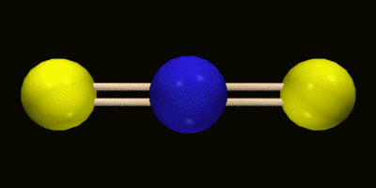
Linear - CO₂

Slide 129
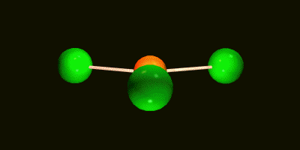
Trigonal planar, BCl₃

Slide 130
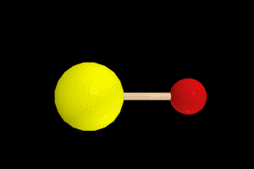
Bent, H₂O

Slide 131
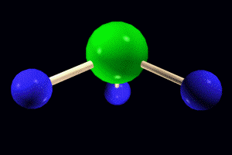
Pyramidal, NH₃

Slide 132
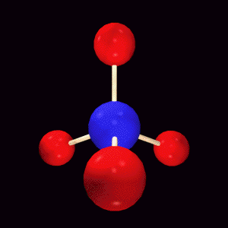
Tetrahedral, CH₄

Slide 133
Molecular geometries based on tetrahedral
H
Tetrahedral
C
O
H
H
H
H
H
Bent
Pyramidal
N
Bent and pyramidal are
actually tetrahedral but
some of the electron
pairs are not bonded.
H
H
H

Slide 134
Other geometries.
Other shapes are also observed.
Five bonds or lone electron pairs
Trigonal bipyramidal
Seesaw
T-shaped
Linear
Six bonds or lone electron pairs
Octahedral
Square pyramidal
Square planar

Slide 135
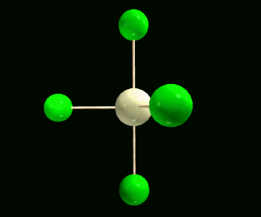
Trigonal bipyramidal

Slide 136
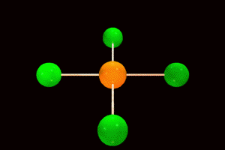
Square planar

Slide 137
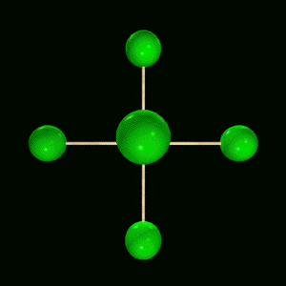
Octahedral

Slide 138
Molecular geometry
H
H
C
H
H
C
H
H
As molecules get larger, the rules regarding
molecular geometry still hold.

Slide 139
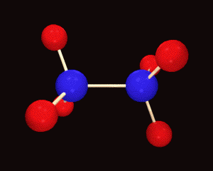
Ethane
Tetrahedral shape around each carbon atom.

Slide 140
VSEPR shapes
Coordination Electron pairs General
Number Bonding Unshared Formula Shape
2 2 0 AB₂ Linear
3 3 0 AB₃ Trigonal planar
2 1 AB₂ Bent
4 4 0 AB₄ Tetrahedral
3 1 AB₃ Trigonal pyramidal
2 2 AB₂ Bent
1 3 AB Linear

Slide 141
VSEPR shapes
Coordination Electron pairs General
Number Bonding Unshared Formula Shape
5 5 0 AB₅ Trigonal
bipyramidal
4 1 AB₄ Seesaw
3 2 AB₃ T-shaped
2 3 AB₂ Linear
6 6 0 AB₆ Octahedral
5 1 AB₅ Square
pyramidal
4 2 AB₄ Square Planar

Slide 142
Polar and nonpolar molecules
Most bonds between atoms of different elements in a molecule are polar. That does not mean that the molecule will be polar.
Electronegativities:
Oxygen = 3.5
Carbon = 2.5
Difference 1.0
(polar bond)
O = C = O
The electronegativity values
Show that the C-O bond would be polar with electrons being pulled towards the oxygens. However, due to the geometry, the pull happens in equal and opposite directions.

Slide 143
Polar and nonpolar molecules
For a molecule to be polar, the effects of bond polarity must not cancel out.
One way is to have a geometry that is not symmetrical like in water.
..
..
O
Electronegativity
difference = 1.3
H H
Here, the effects of the polar bonds do not cancel, so the molecule is polar.

Slide 144
Polar and nonpolar molecules
Polarity is an important property of molecules.
It affects physical properties such as melting point, boiling point and solubility.
Chemical properties also depend on polarity.
Dipole moment, µ, is a quantitative measure of the polarity of a molecule.
The dipole moment increases as the magnitude of the charge that is separated increases and as the distance between the charges increases.

Slide 145
Dipole moment
This property can be measured by placing molecules in an electrical field. Polar molecules will align when the field is on. Nonpolar molecules will not.
+
-
+
-

Slide 146
Polar and nonpolar molecules
A molecule is nonpolar if the central atom is symmetrically substituted by identical atoms.
CO₂, CH₄ , CCl₄
A molecule will be polar if the geometry is not symmetrical.
H₂O, NH₃, CH₂Cl₂
The degree of polarity is a function of the number and type of polar bonds as well as the geometry.

Slide 147
Geometry and polar molecules
For a molecule to be polar
  - must have polar bonds
  - must have the proper geometry
        CH₄ non-polar
        CH₃Cl polar
  CH₂Cl₂ polar
        CHCl₃ polar
        CCl₄ non-polar
WHY?

Slide 148
Bonding theory
Two methods of approximation are used to describe bonding between atoms.
Valence bond method
Bonds are assumed to be formed by overlap of atomic orbitals
Molecular orbital method
When atoms form compounds, their orbitals combine to form new orbitals - molecular orbitals.

Slide 149
Valence bond method
According to this model, the H-H bond forms as a result of the overlap of the 1s orbitals from each atom. The bonding pair held directly between both nuclei and is called a sigma (σ) bond.
74 pm

Slide 150
Valence bond method
Multiple bonds are formed by the side-to-side overlap of orbitals. The bonding pair is held above and below the two nuclei and is called a pi (π) bond.
π bond
C₂H₄
σ bond
π overlap

Slide 151
Valence bond method
Hybrid orbitals are need to account for the geometry that we observe for many molecules.
Example - Carbon
Outer electron configuration of 2s² 2p_{x}¹ 2p_{y}¹
We know that carbon will form four equivalent bonds - CH₄, CH₂Cl₂ , CCl₄.
The electron configuration appears to indicate that only two bonds would form and they would be at right angles -- not tetrahedral angles.

Slide 152
Hybridization
To explain why carbon forms four identical single bonds, we assume the the original orbitals will blend together.
2p
2sp³
energy
2s
Unhybridized Hybridized

Slide 153
Hybridization
In the case of a carbon that has 4 single bonds, all of the orbitals are hybrids.
sp³
25% s and 75% p character
1
+ 3
4
s p sp³

Slide 154
Ethane, CH₃CH₃
sp³
hybrids
σ bond - formed
by an endwise
(head-on) overlap.
Molecules are
able to rotate
around single
bonds.
Ó bond
1s orbital
from H

Slide 155
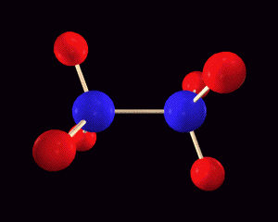
Rotation of single bond
Ethane , CH₃CH₃

Slide 156
sp² hybrid orbitals
To account for double bonds, a second type of hybrid orbital must be pictured. An sp² hybrid is produced by combining one s and 2 p orbitals. One p orbital remains.
2p
2p
2sp²
energy
2s
Unhybridized Hybridized

Slide 157
sp² hybrid orbitals
The unhybridized p orbitals are able to overlap, resulting in the formation of a second bond - π bond.
A π bond is a
sideways overlap
that occurs both
above and below the
plane of the molecule
Parts of the molecule
are no longer able to
rotate about the bond.
C
C

Slide 158
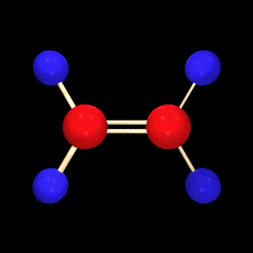
Ethene

Slide 159
Bonding in ethene
1s orbital
π overlap
sp²
hybrids
σ bond
sp²
hybrids
π overlap
π bond

Slide 160
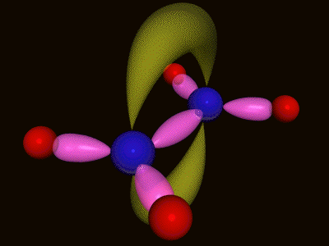
Bonding in ethene

Slide 161
sp hybrid orbital
Forming a triple bond is also possible. This requires that two p orbitals remain unhybridized.
2p
2p
energy
2sp
2s
Unhybridized Hybridized

Slide 162
sp hybrid orbital
Now two p orbitals are available to
form π bonds.

Slide 163
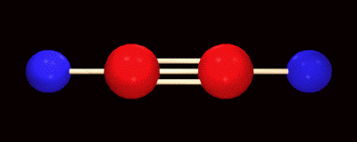
Ethyne

Slide 164
Bonding in ethyne
sp hybrid
π overlaps

Slide 165
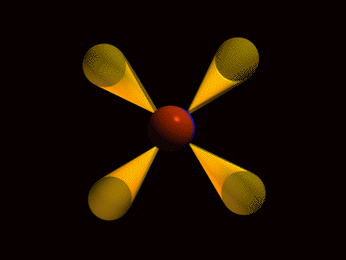
Bonding in ethyne

Slide 166
Other hybrid orbitals
d orbitals can also be involved in the formation of hybrid orbitals.
Hybrid Shape
sp Linear
sp² Trigonal planar
sp³ Tetrahedral
sp³d Trigonal bipyramidal
sp³d ² Octahedral
sp³d ³ Pentagonal bipyramidal

Slide 167
Molecular Orbital Method
When atomic orbitals combine to form molecular orbitals, the number of molecular orbitals formed must equal the number of atomic orbitals mathematically combined.
Example - H₂
Two 1s orbitals will combine forming two molecular orbitals. The overall energy of the new orbitals is the same as the original two 1s. However, they will be at different energies.

Slide 168
H₂ molecular orbital diagram
σ *_{1s}
energy
1s
1s
H
H
σ _{1s}
H₂
Orbital shapes

Slide 169
Molecular orbitals
When two atomic orbitals combine, three types of molecular orbitals are produced.
Bonding orbital - σ or π
The energy is lower than the atomic orbitals and the electron density overlaps.
Antibonding orbital - σ * or π*
The energy is higher than the atomic orbitals and the electron density does not overlap.
Nonbonding - n
Electron pairs not involved in bonding.

Slide 170
MO diagram of helium
If we develop a
diagram for helium
we see that both
a bonding and
antibonding
orbital will be
filled.
The result is that
it is no more stable
than the unbonded
form -- it will not
bond
σ *_{1s}
energy
1s
1s
He
He
σ _{1s}
He₂

Slide 171
Molecular orbital bonding
For a molecule to be stable, you must have more electrons in bonding orbitals than in antibonding orbitals.
The bonded form will be at a lower energy so will be more stable.
#bonds formed=bonding e⁻ -antibonding e⁻
2

Slide 172
MO diagram for O₂
π*_{2pz}
π*_{2px}
π*_{2py}
2p_{x} 2p_{y} 2p_{z}
2p_{x} 2p_{y} 2p_{z}
π _{2px}
π _{2py}
π_{2pz}
σ *_{2s}
2s
2s
σ _{2s}
σ *_{1s}
1s
1s
σ _{1s}
#bonds formed = 10 bonding e⁻ - 6 antibonding e⁻ 2
= 2

Slide 173
MO diagram for NO
π * _{2px}
π *_{2py}
π *_{2pz}
2p_{x} 2p_{y} 2p_{z}
π _{2py}
π _{2pz}
2p_{x} 2p_{y} 2p_{z}
π _{2px}
2s
σ *_{2s}
2s
σ _{2s}
σ *_{1s}
1s
σ _{1s}
1s
N
NO
O
# bonds = 10 bonding e⁻ - 5 antibonding e⁻ = 2.5
2

Slide 174
Delocalized electrons
MO diagrams for polyatomic species are often simplified by assuming that all σ and some π orbitals are localized -- shared between two specific atoms.
Resonance structures require that electrons in some π orbitals be pictured as delocalized.
Delocalized - free to move around three or more atoms.

Slide 175
Delocalized electrons
Benzene is a good example of delocalized electrons.
We know that the bonding between carbons has an order of 1.5 and that all of the bonds are equal.
=

Slide 176
Aromatic hydrocarbons
H
H
H
H
H
H
p orbitals overlap
sidewise all around
the ring. No localized
double bonds.

Slide 177
Band theory of bonding in solids
This is an extension of delocalized orbitals.
Each atom interacts with all of the others in the crystal, resulting in an enormous number of ‘molecular orbitals.’
3s
Na
3s
Na

Slide 178
Band theory of bonding in solids
Band
A group of very closely spaced energy levels.
Energy gap
The difference in energy between the bonding and antibonding orbitals.
Forbidden bands
A ‘space’ that separates bands.

Slide 179
Band theory of bonding in solids
Conductor - A material with a partially filled energy band.
Insulator - The highest occupied band is filled or almost completely filled. The forbidden band just above the highest filled is wide.
Semiconductor - The gap between the highest filled band and the next higher permitted band is relatively narrow.

Slide 180
Band theory of bonding in solids
Empty
Energy
Forbidden, wide
Filled
insulator
Empty
Energy
Forbidden, narrow
Filled
semiconductor
No
Forbidden
Energy
conductor

