Slide 1
Thermodynamics Follow-up

Slide 2
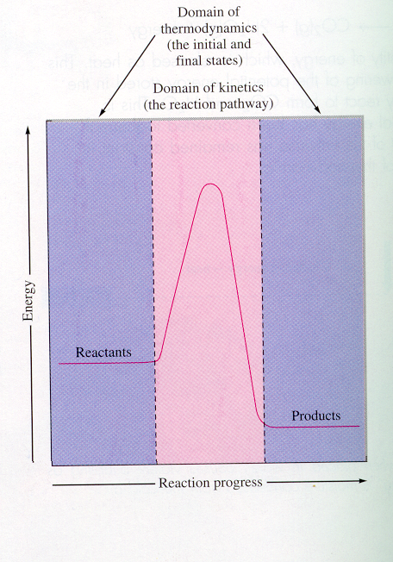
Kinetics
The reaction pathway
Thermodynamics
the initial and final states

Slide 3
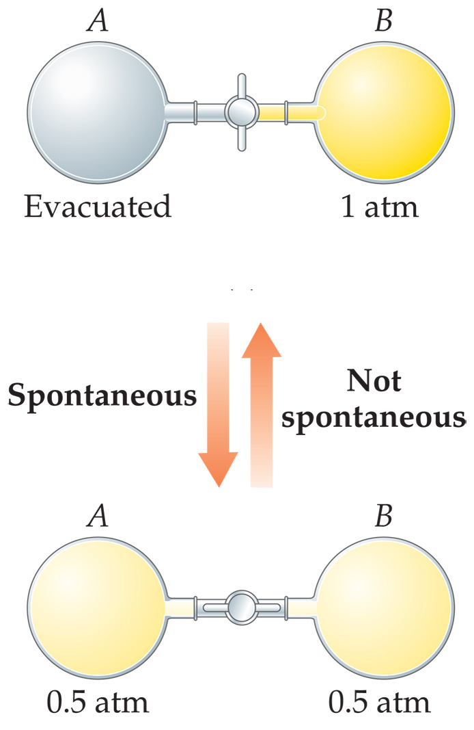
Spontaneous Processes
Spontaneous processes are those that can proceed without any outside intervention.
The gas in vessel B will spontaneously effuse into vessel A, but once the gas is in both vessels, it will not spontaneously return to vessel B.

Slide 4
2nd Law of Thermo
Entropy in the universe is increasing
The driving force for spontaneous processes is an increase in Entropy
  Natural tendency is to go from ordered to disordered
  Take a deck of cards. Throw them into air. When you put them back, what are the chances they are all in order?
    But there is a chance, however unlikely.

Slide 5
2nd Law
Entropy is a function that describes the number of possible arrangements available to a particular system.
  Nature proceeds toward the states that have the highest probability of existing
  The driving force is “probability”

Slide 6
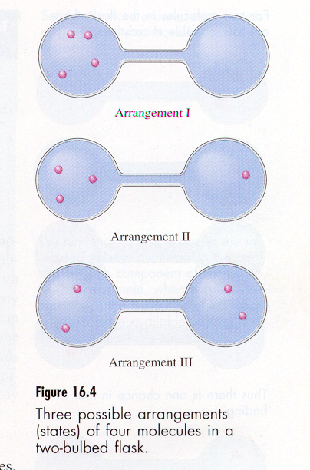
Let’s Look at a Simple System
Four atoms of an ideal gas
Three possible arrangements
How many ways can each state be achieved?

Slide 7
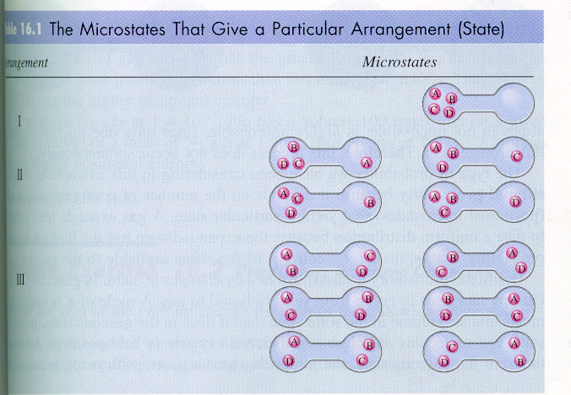
Examine All Possibilities

Slide 8
Possibilities
The arrangement with three on one side and one on the other is most likely to occur.
The probability of finding all
4 atoms on the left side is
(1/2)(1/2)(1/2)(1/2) = 1/16
The probability for a mole of
particles would be (1/2) ^{6.02x1023}
By the ratio of 2:8:6

Slide 9
Positional Entropy
A gas expands into a vacuum
  Because the expanded state has the highest positional probability or entropy of all the states available to the gas
Illustrated by changes of state
  The larger the intermolecular distances, the more microstates available
    The more microstates, the more entropy

Slide 10

Coffee Cup
Explain on a molecular level how a hot cup of coffee cools to room temperature
What is the possibility of this whole process going in reverse?
But it is possible! Next time your coffee is cold, just wait for
it to get hot.

Slide 11
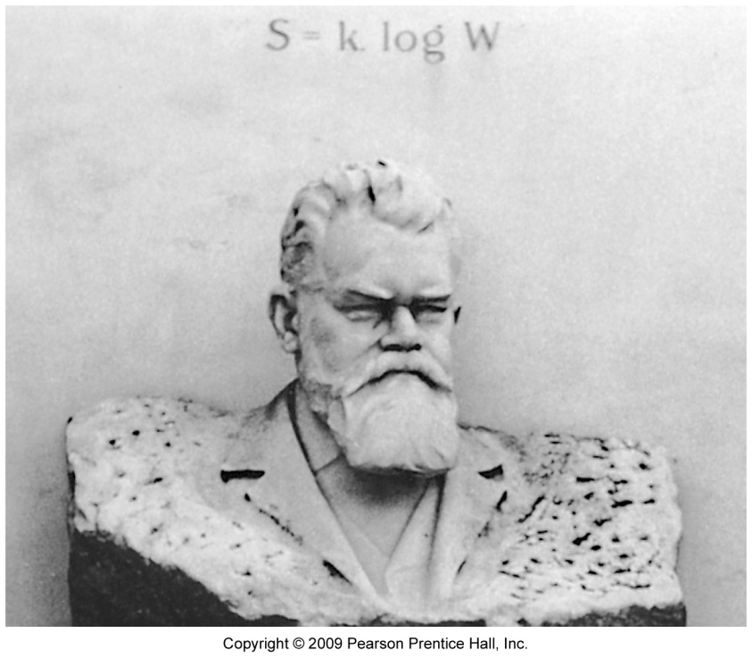
Entropy on the Molecular Scale
Ludwig Boltzmann described the concept of entropy on the molecular level.
Temperature is a measure of the average kinetic energy of the molecules in a sample.

Slide 12
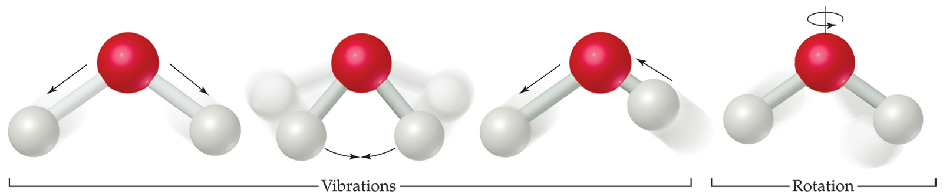
Entropy on the Molecular Scale
Molecules exhibit several types of motion:
  Translational: Movement of the entire molecule from one place to another.
  Vibrational: Periodic motion of atoms within a molecule.
  Rotational: Rotation of the molecule on about an axis or rotation about σ bonds.
  All of these are considered microstates of a system.
Notes:
€

Slide 13
Entropy on the Molecular Scale
Each molecule has a specific number of microstates, W, associated with it.
Entropy is
S = k lnW
where k is the Boltzmann constant, 1.38 × 10⁻²³ J/K.

Slide 14
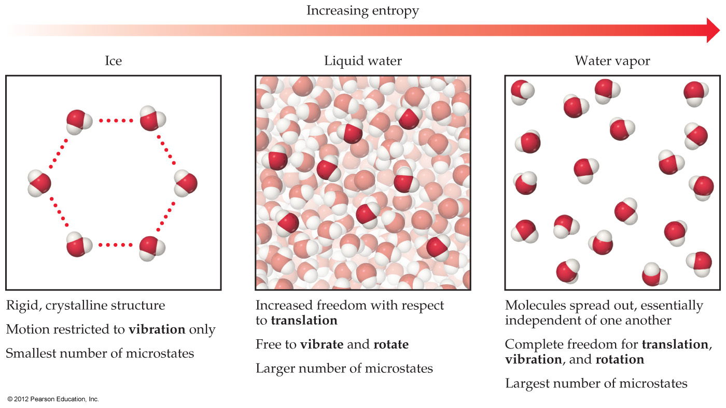
Notes:
Figure 19.9 Entropy and the phases of water

Slide 15
Entropy on the Molecular Scale
The change in entropy for a process, then, is
ΔS = k lnW_{final} − k lnW_{initial}
W_{final}
W_{initial}
ΔS = k ln
Entropy increases with the number of microstates in the system.

Slide 16
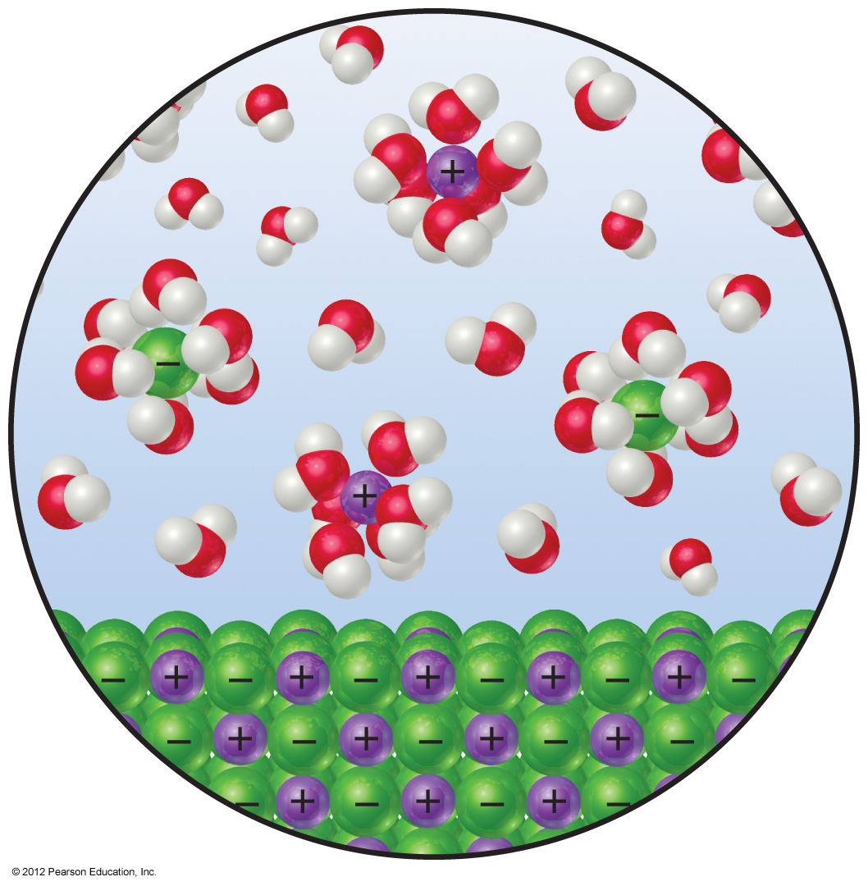
Notes:
Figure 19.10 Entropy changes when an ionic solid dissolves in water.

Slide 17
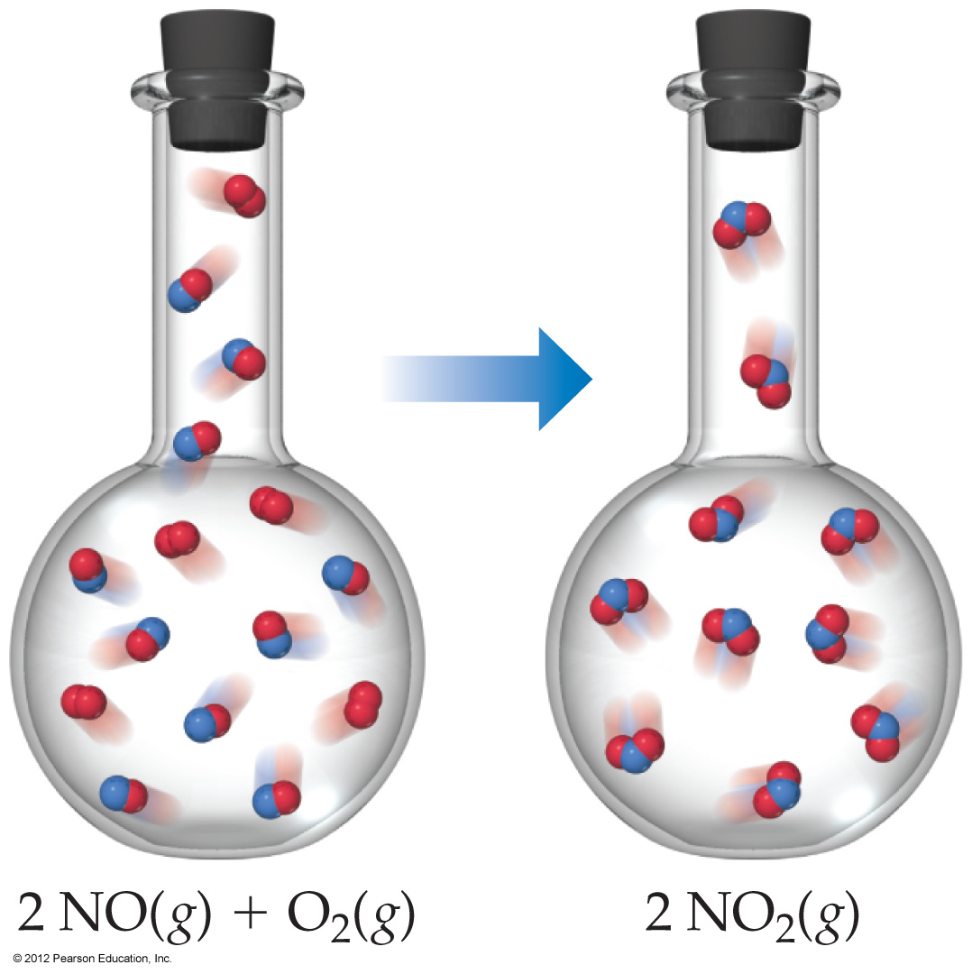
Notes:
Figure 19.11 Entropy decreases when NO(g) is oxidized by O₂(g) to NO₂(g).

Slide 18
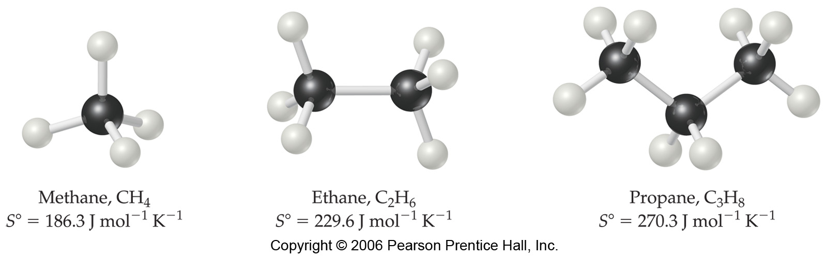
Standard Entropies
Larger and more complex molecules have greater entropies.

Slide 19
Entropy
Kinetic-molecular view
For an ideal gas at one atmosphere of pressure, as the temperature is lowered, the volume will be reduced.
At 0 K, the molecules will have no energy of motion.
There is only one possible arrangement for the molecules.
Ideal gas at one
atm and 0 K.

Slide 20
Entropy and temperature
The entropy of an ideal gas at constant pressure increases with increasing temperature.
This is because the volume increases.
0 K T₁ T₂ T₃

Slide 21
Entropy and temperature
There are other reasons for entropy to increase with increasing temperature.
Increased temperature will result in a greater distribution of molecular speeds.
T₁
T₂
number
T₁ < T₂ < T₃
T₃
speed

Slide 22
Entropy and temperature
Increased temperature also results in more energy levels in atoms and molecules being occupied.
For molecules, this means that they will be able to rotate and their bonds can vibrate.
This further increases entropy.

Slide 23
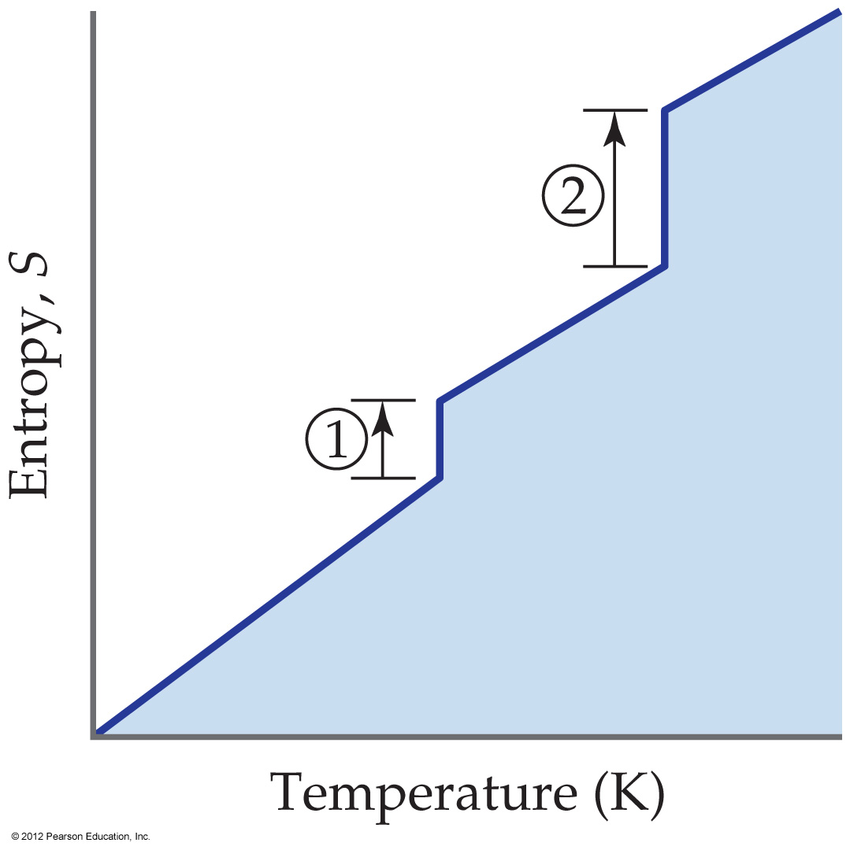
Notes:
Chapter 19, Unnumbered Figure 3, Page 818

Slide 24
How can we determine if a process is spontaneous?
ΔS_{universe =} ΔS_{system} + ΔS_{surroundings}
The sign of ΔS_{surr} depends on direction of heat flow
  exothermic process adds energy to the universe
  The universe now has more random motion
  So the universe experiences an increase in entropy
ΔS_{universe} > 0 or positive.

Slide 25
ΔS_{surrounding}
Magnitude of ΔS_{surr} depends on the temperature
If the surroundings have a low temp, additional energy makes a big difference
If the surroundings have a high temperature, additional heat does not add much more energy (entropy) it has little effect.
(little change, small ΔS_{surr})

Slide 26
Entropy Continued
The tendency for a system to lower its energy becomes more important at lower temperatures.
Driving Force
Provided by
energy flow
Magnitude of the
Entropy change of
The surroundings
Quantity of heat (J)
temperature (K)

Slide 27
Entropy depends on Enthalpy
The change in Enthalpy, ΔH, which is the direction and magnitude of heat exchanged
Energy of system is proportional to its temp in kelvin in an isothermal system.
Change in enthalpy
exotherm = neg
endotherm = pos
J = - ΔH = ΔS_{surr}
K T

Slide 28
Spontaneity
ΔS system | ΔS Surrounding | ΔS Universe | Spontaneous?
+ | + | + | Yes
- | - | - | No (process in opposite direction
+ | - | ? | Yes if ΔS_{sys} > ΔS_{surr}
- | + | ? | Yes if ΔS_{sys} < ΔS_{surr}

Slide 29
Gibbs Free Energy
There is a “war” between
  order and disorder
  Enthalpy and Entropy
The sun is the source of our energy
  It drives our enthalpic world
  If the sun were to stop, how long would live still exist.
  In a million years would things still look the same?

Slide 30
G = H - T S
This war can be described mathematically
G is Gibbs Free Energy
  Gibbs Free Energy is the energy “free” to do work
  We will use this to determine the “force” behind reactions
Remember the second law!

Slide 31
Free Energy
G = Gibbs Free Energy
G = H – TS
In processes where temp is constant
ΔG = ΔH - T ΔS
We are referring to the system
  No subscripts needed

Slide 32
Free Energy
ΔG = ΔH - T ΔS_{sys} If we divide by –T
-ΔG = - ΔH + ΔS_{sys} - ΔH = ΔS_{surr}
T T T
-ΔG = ΔS_{surr} + ΔS_{sys} = ΔS_{univ} at constant T, P
T
At what value of ΔG , is ΔS_{univ} > 0 or “spontaneous”

Slide 33
Spontaneity Again
Processes are spontaneous
        H₂O_{(s)} → H₂O _{(l)}
        ΔH = 6.03 x 10³ J/mol
ΔS = 22.1 J/K • mol
  If they have a positive ΔS_{univ}
  If they have a negative ΔG , at constant P,T
ΔG = ΔH - T ΔS_{sys}
Spontaneous processes have negative ΔG

Slide 34
Is Water Melting Spontaneous?
Will this be spontaneous at -10, 0, or 10ºC?
H₂O_{(s)} → H₂O _{(l)}
  ΔH = 6.03 x 10³ J/mol
ΔS = 22.1 J/K • mol
ΔG = ΔH - T ΔS_{sys}

Slide 35
Calculate ΔS_{unv} and ΔG
ΔH = 6.03 x 10³ J/mol
ΔS = 22.1 J/K • mol
ΔG = ΔH - T ΔS_{sys}
T (°C) | T K | -ΔH = ΔS_{surr} T | ΔS + ΔS_{surr}=ΔS_{unv} | TΔS X 10³ | ΔG
-10 | 263 | -22.9 | -0.8 | 5.81 | + 2.2 x10²
0 | 273 | -22.1 | 0 | 6.03 | 0
10 | 283 | -21.3 | +0.8 | 6.25 | - 2.2 x10²

Slide 36
The spontaneity of the process depends on the temp
ΔS | ΔH | Result
Positive | Negative | Spontaneous at All temps
Positive | Positive | Spontaneous at High Temps (exotherm not important)
Negative | Negative | Spontaneous at Low Temps (Exotherm is important)
Negative | Positive | Not Spontaneous Process Reverse spontaneous at all temps

Slide 37
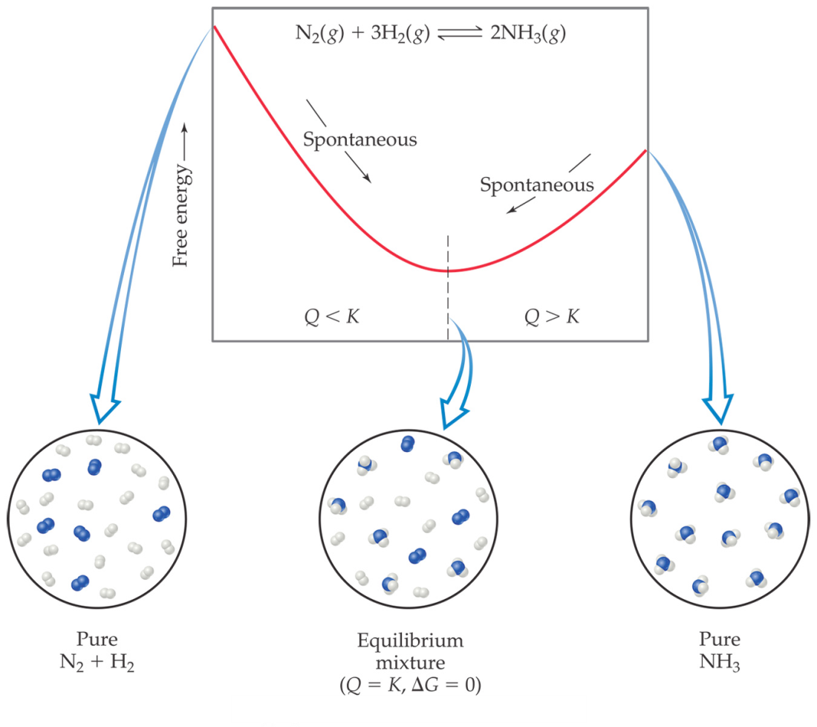
Gibbs Free Energy
If ΔG is negative, the forward reaction is spontaneous.
If ΔG is 0, the system is at equilibrium.
If ΔG is positive, the reaction is spontaneous in the reverse direction.

Slide 38
Try this!
At 25ºC the equilibrium constant, Kp, for the reaction is below is 0.281atm.
Br_{2 (l)} → Br_{2 (g)}
a) Calculate ∆Gº for the reaction.
b) it takes 193J to vaporize 1.00g of Br_{2 (l)} at 25ºC and 1.00atm pressure. Calculate ∆Hº for this reaction.
c) Calculate ∆Sº at 298K for this reaction.
d) What is the normal boiling point of bromine?
e) What is the equilibrium vapor pressure?

Slide 39
Answer
∆Gº = -RTlnK = - (8.314J/molK)(298K)(ln.281)
= 3.15kJ/mol
(193kJ/g)(160g/mol) = 30.9kJ/mol
∆Gº = ∆Hº - T ∆Sº
3.15kJ/mol = 30.9kJ/mol – 298K ∆Sº
∆Sº = 93.1J/molK
∆G = ∆H - T ∆S
0 = 30.9kJ/molK – T (0.0931kJ/molk)
T = 332K
Kp = P_{Br2} = 0.281atm

Slide 40
Now try this!
Ethanol could be created by the following reaction:
a) Calculate the ∆Hº for the reaction.
b) Calculate the ∆Sº for the reaction.
c) Calculate the ∆Gº for the reaction.
d) Calculate the value for K.
 | 2C_{(s)} + | 2H_{2 (g)} + | H₂O_{(l)} → | C₂H₅OH_{(l)}
∆H_{f}º kJ/mol | 0 | 0 | -285.5 | -277.69
∆Sº J/molK | 5.740 | 130.6 | 69.91 | 160.7

Slide 41
Answer
a) ∆Hº = ∑ ∆H_{f}º_{(products)} - ∑ ∆H_{f}º_{(reactants)}
(-277.69) - (-285.5) = +7.81kJ/mol
b) ∆Sº = ∑ ∆Sº_{(products)} - ∑ ∆Sº_{(reactants)}
(160.7 + 69.91) – (5.740 + 130.6) = -181.9 J/molK
c) ΔGº = ΔHº - T ΔSº
ΔGº = +8.16kJ/mol – (298K)(-0.1819 kJ/molK)
= 62.0 kJ/mol
d) ΔGº = -RTlnK
lnK = (+62.0kJ/mol)/{(0.008314kJ/molK)(298K)}
K = e^{-25.0} = 7.38x10⁻¹⁰

