Slide 1
Kinetics Follow-up

Slide 2
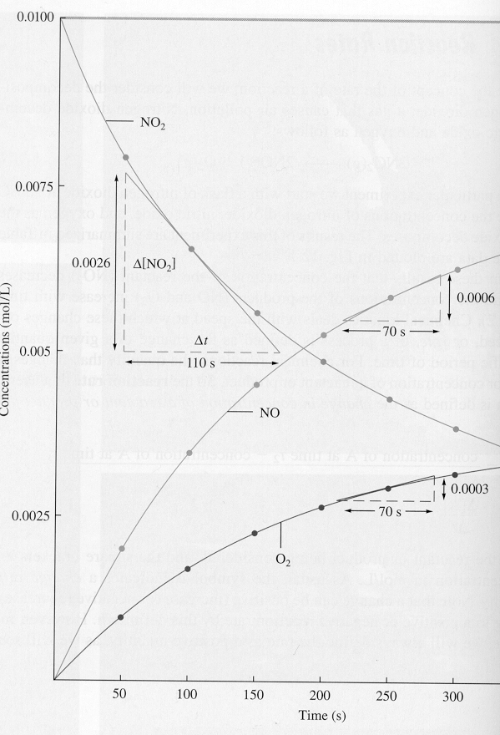
Average Rate
Instantaneous rate of reactant disappearance
Instantaneous rate of product formation

Slide 3
Mechanisms
Reactions take place over the course of several steps.
In some cases pieces of particles with unpaired electrons called radicals form as transition states before temporarily forming intermediates.
The different steps have different rates.
The overall rate of the reaction is closest to the rate of the slowest step.
This is why the order is not exactly matching the stoichiometric coefficients for most reactions.

Slide 4
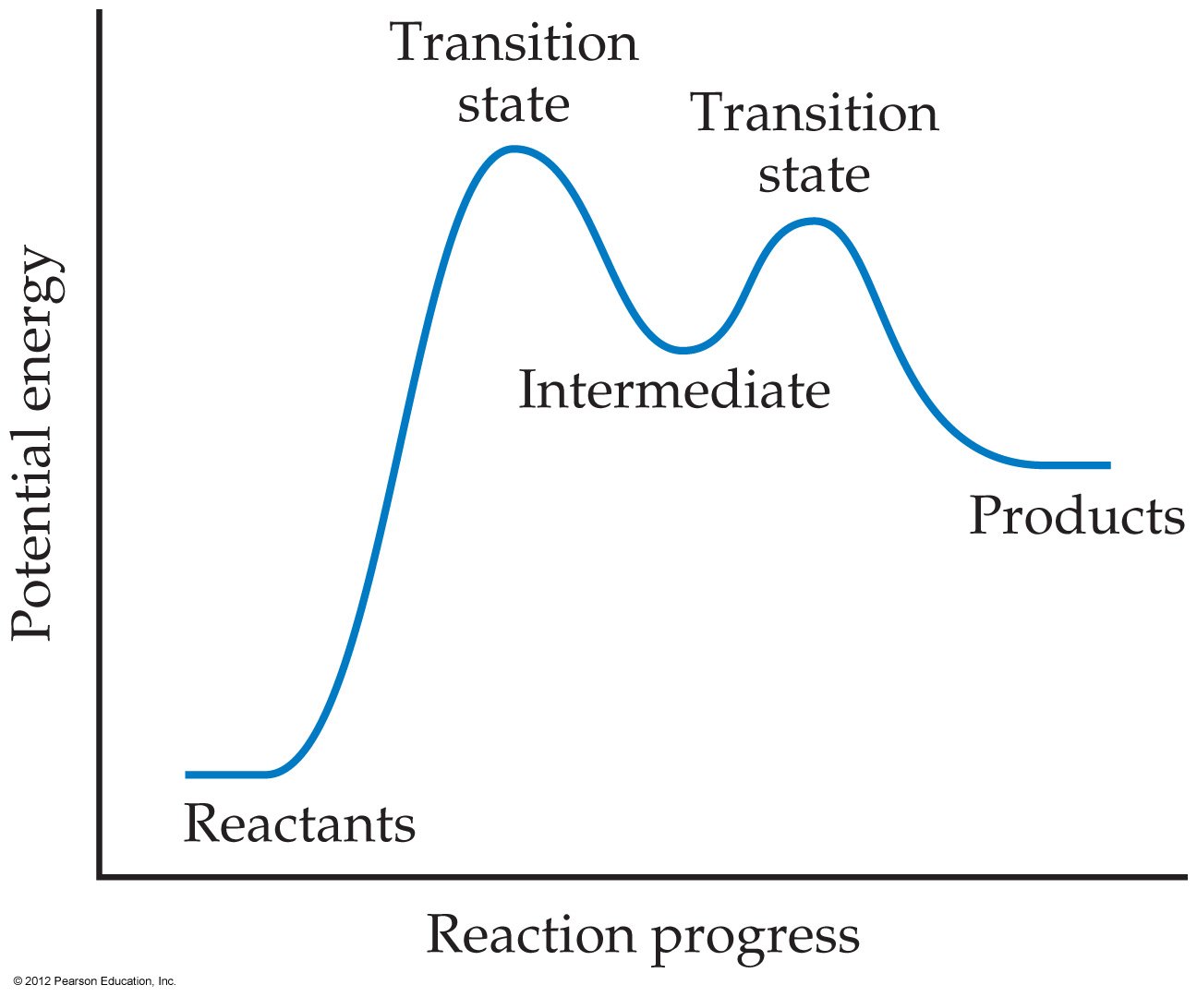
Notes:
Figure 14.20 The energy profile of a reaction, showing transition states and an intermediate.

Slide 5
Slow first steps
Step 1: NO₂ + NO₂ → NO₃ + NO (slow)
Step 2: NO₃ +CO → NO₂ + CO₂ (fast)
Overall reaction
NO₂ + CO → NO + CO₂
Rate = k[NO₂]² (matches all reactants needed for the slow step)

Slide 6
Fast First Steps
Reaction : NO + Br₂ → 2NOBr
Step 1: NO + Br₂ → NOBr₂ (fast)
Step 2: NOBr₂ + NO → 2NOBr (slow)
Rate = k[NO]²[Br₂]
All reactants necessary for the first reaction and the second reaction are in the rate law, and all intermediates are removed.

Slide 7
Try this!
Step 1: 2NO → N₂O₂ (Fast)
Step 2: N₂O₂ + H₂→ N₂O + H₂O (Slow)
Step 3: N₂O + H₂ → N₂ + H₂O (Fast)
What is the overall reaction?
What is the rate Law?
If the rate law turned out to be k[NO]²[H₂]² the what is the rate determining step?
What are the intermediates?

Slide 8
Answer
2NO + 2H₂ → N₂ + 2H₂O
Rate = k[NO]²[H₂]
Step 3
N₂O₂ and N₂O

Slide 9
Order of Reaction
A + B → C
Rate = k[A]^{n} [B]^{m}
(n + m) = order of the reaction
  = 1 unimolecular
  =2 bimolecular
  =3 trimolecular
  This means how many particles are involved in the rate determining step

Slide 10
Method of Initial Rates
A series of experiments are run to determine the order of a reactant.
The reaction rate at the beginning of the reaction and the concentration are measured
These are evaluated to determine the order of each reactant and the overall reaction order

Slide 11
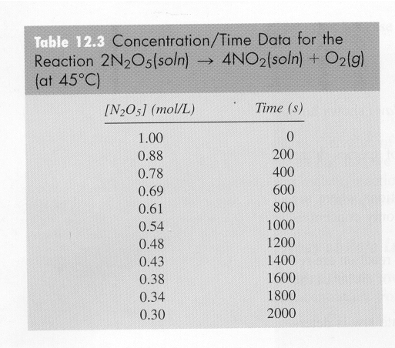
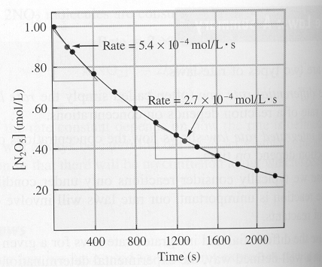
If you plot the concentration versus time of [N₂O₅],
you can determine the rate at 0.90M and 0.45M.
What is the rate law for this reaction?
Rate = k [N₂O₅]^{n} n = the order. It is determined experimentally.

Slide 12
2N₂O_{5(soln)} → 4NO_{2(soln)} + O_{2(g)}
At 45°C, O₂ bubbles out of solution, so only the forward reaction occurs.
Data
[N₂O₅] Rate ( mol/l • s) 0.90M 5.4 x 10⁻⁴ 0.45M 2.7 x 10⁻⁴
The concentration is halved, so the rate is halved

Slide 13
2N₂O_{5(soln)} → 4NO_{2(soln)} + O_{2(g)}
Rate = k [N₂O₅]^{n}
5.4 x 10⁻⁴ = k [0.90]^{n}
2.7 x 10⁻⁴ = k [0 45]^{n} after algebra
2 = (2)^{n}
n = 1 which is determined by the experiment
Rate = k [N₂O₅]¹

Slide 14
NH₄⁺ + NO₂⁻ → N₂ + 2H₂O
Rate = k[NH₄⁺¹]^{n} [NO₂⁻¹]^{m}
How can we determine n and m? (order)
Run a series of reactions under identical conditions. Varying only the concentration of one reactant.
Compare the results and determine the order of each reactant

Slide 15
NH₄⁺ + NO₂⁻ → N₂ + 2H₂O
Experiment | [NH₄]⁺ Initial | [NO₂]⁻ Initial | Initial Rate Mol/L ·s
1 | 0.001M | 0.0050 M | 1.35 x 10⁻⁷
2 | 0.001M | 0.010 M | 2.70 x 10⁻⁷
3 | 0.002M | 0.010M | 5.40 x 10⁻⁷

Slide 16
NH₄⁺ + NO₂⁻ → N₂ + 2H₂O
Compare one reaction to the next
1.35 x 10⁻⁷ = k(.001)^{n}(0.050)^{m}
2.70 x 10⁻⁷ = k (0.001)^{n}(0.010)^{m}
Exp | [NH₄]⁺ Initial | [NO₂]⁻ Initial | Initial Rate Mol/L ·s
1 | 0.001M | 0.0050 M | 1.35 x 10⁻⁷
2 | 0.001M | 0.010 M | 2.70 x 10⁻⁷
3 | 0.002M | 0.010M | 5.40 x 10⁻⁷

Slide 17
1.35 x 10⁻⁷ = k(0.001)^{n}(0.0050)^{m}
2.70 x 10⁻⁷ k (0.001)^{n}(0.010)^{m}
1.35 x 10⁻⁷ = (0.0050)^{m}
2.70 x 10⁻⁷ (0.010)^{m}
1/2 = (1/2)^{m}
m = 1
In order to find n, we can do the same type of math
with the second set of reactions

Slide 18
NH₄⁺ + NO₂⁻ → N₂ + 2H₂O
Compare one reaction to the next
2.70 x 10⁻⁷ = k (0.001)^{n}(0.010)^{m}
5.40 x 10⁻⁷ = k(.002)^{n}(0.010)^{m}
Exp | [NH₄]⁺ Initial | [NO₂]⁻ Initial | Initial Rate Mol/L ·s
1 | 0.001M | 0.0050 M | 1.35 x 10⁻⁷
2 | 0.001M | 0.010 M | 2.70 x 10⁻⁷
3 | 0.002M | 0.010M | 5.40 x 10⁻⁷

Slide 19
2.70 x 10⁻⁷ = k (0.001)^{n}(0.010)^{m}
5.40 x 10⁻⁷ k(.002)^{n}(0.010)^{m}
0.5 = (0.5)^{n}
n = 1
n + m = order of the reaction
1 + 1 = 2 or second order

Slide 20
You try!
The reaction:
  I⁻_{(aq)} + OCl⁻_{(aq)} → IO⁻_{(aq)} + Cl⁻_{(aq)}
  Was studied and the following data obtained:
  What is the rate law and the rate constant?
[I⁻]_{o} (mol/L) | [Ocl⁻]_{o} (mol/L) | Initial Rate (mol/Ls)
0.12 | 0.18 | 7.91x10⁻²
0.060 | 0.18 | 3.95x10⁻²
0.030 | 0.090 | 9.88x10⁻³
0.24 | 0.090 | 7.91x10⁻²

Slide 21
Answer:
Rate = k[I⁻]^{x}[OCl⁻]^{y}
7.91x10⁻² = k(0.12)^{x}(0.18)^{y}
3.95x10⁻² k(0.060)^{x}(0.18)^{y}
2.00 = 2.0^{x} x=1
3.95x10⁻² = k(0.060)¹(0.18)^{y}
9.88x10⁻³ k(0.030)¹(0.090)^{y}
4.00 = (2)(2^{y}) y=1
Rate = k[I⁻][OCl⁻]
7.91x10⁻²mol/Ls = k(0.12M)(0.18M) = 3.7L/mol s

Slide 22
The Integrated Rate Law
Expresses how concentrations depend on time
Depends on the order of the reaction
Remember
Rate = k[A]^{n}[B]^{m}
  Order = n + m
Integrated Rate law takes the form by “integrating” the rate function. (calculus used to determine)
  The value of n and m change the order of the reaction
  The form of the integrated rate depends on the value of n
  You get a different equation for zero, first and second order equations.

Slide 23
Reaction Order
Order of the reaction determines or affects our calculations.
Zero order indicates the use of a catalyst or enzyme. The surface area of catalyst is the rate determining factor.
First or second order is more typical (of college problems)

Slide 24
Integrated Law - Zero Order
Rate = - Δ[A] = k
Δt
Set up the differential equation
d[A] = -kt
Integral of 1 with respect to A is [A]

Slide 25
Integrated Rate Law – First Order
Rate = Δ[A] = k [A] ^{n}
Δt
If n = 1, this is a first order reaction. If we “integrate” this equation we get a new form.
Ln[A] = -kt + ln[A₀]
where A₀ is the initial concentration

Slide 26
Why?
If Rate = - Δ[A] = k [A] ¹
Δt
Then you set up the differential equation:
d[A] = -kdt
[A]
Integral of 1/[A] with respect to [A] is the ln[A].

Slide 27
Integrated Rate Law
ln[A] = -kt + ln[A]₀
The equation shows the [A] depends on time
If you know k and A₀, you can calculate the concentration at any time.
Is in the form y = mx +b
  Y = ln[A] m = -k b = ln[A]₀
  Can be rewritten ln( [A]₀/[A] ) = kt
This equation is only good for first order reactions!

Slide 28
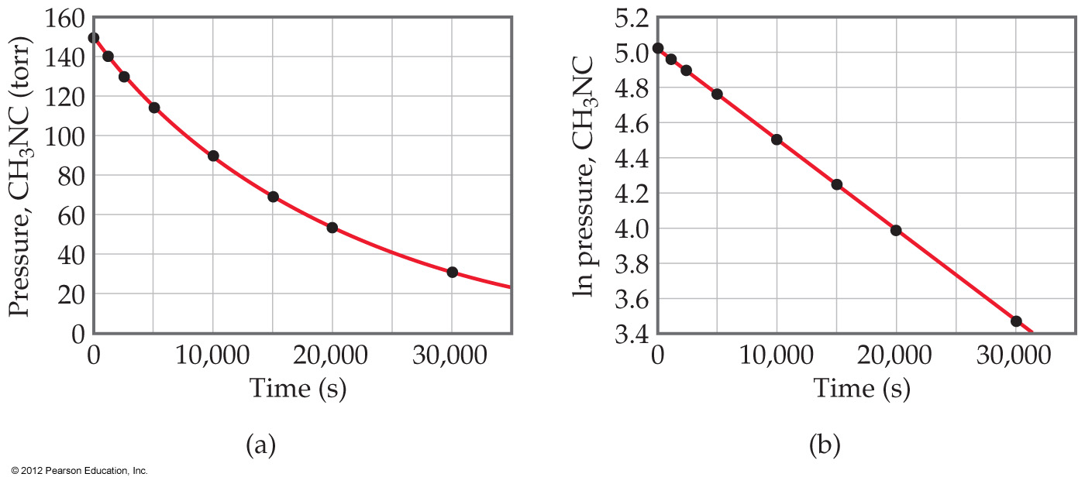
Notes:
Figure 14.8 Kinetic data for conversion of methyl isonitrile into acetonitrile.

Slide 29
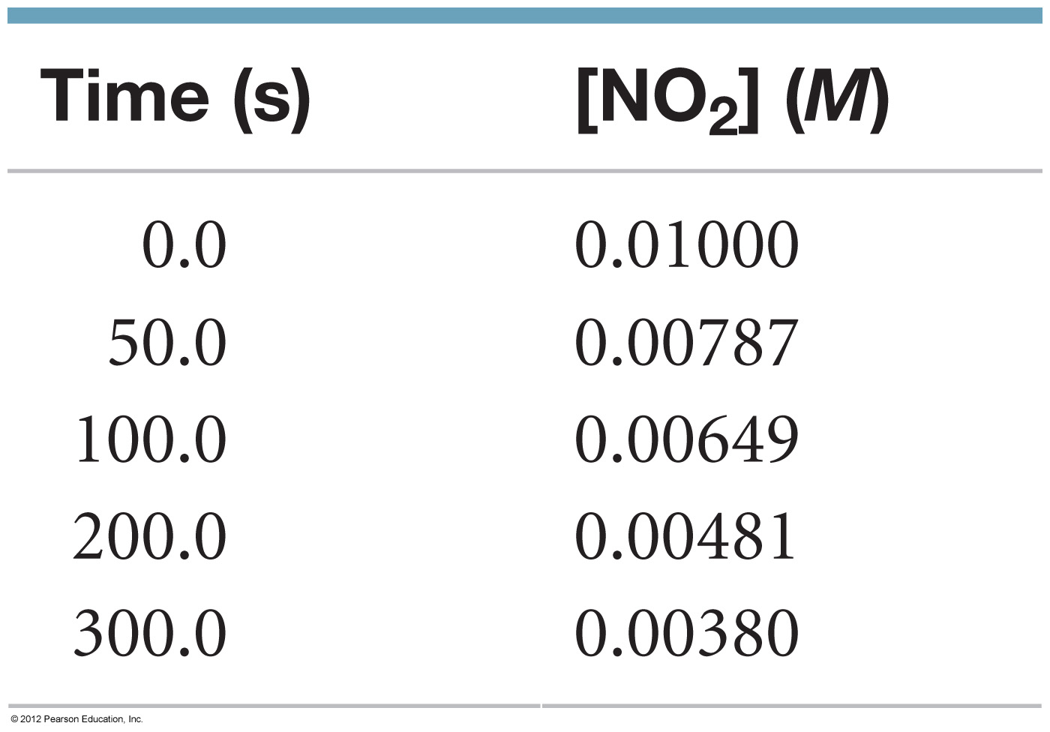
Notes:
Chapter 14, Unnumbered Table 1, Page 572

Slide 30
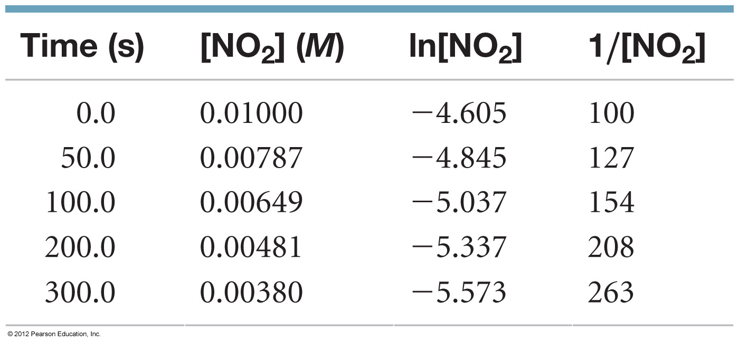
Notes:
Chapter 14, Unnumbered Table 2, Page 572

Slide 31
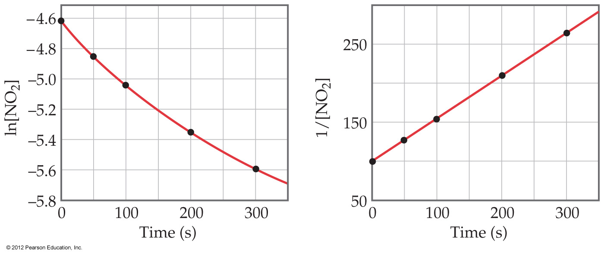
Notes:
Figure 14.9 Kinetic data for decomposition of NO₂.

Slide 32
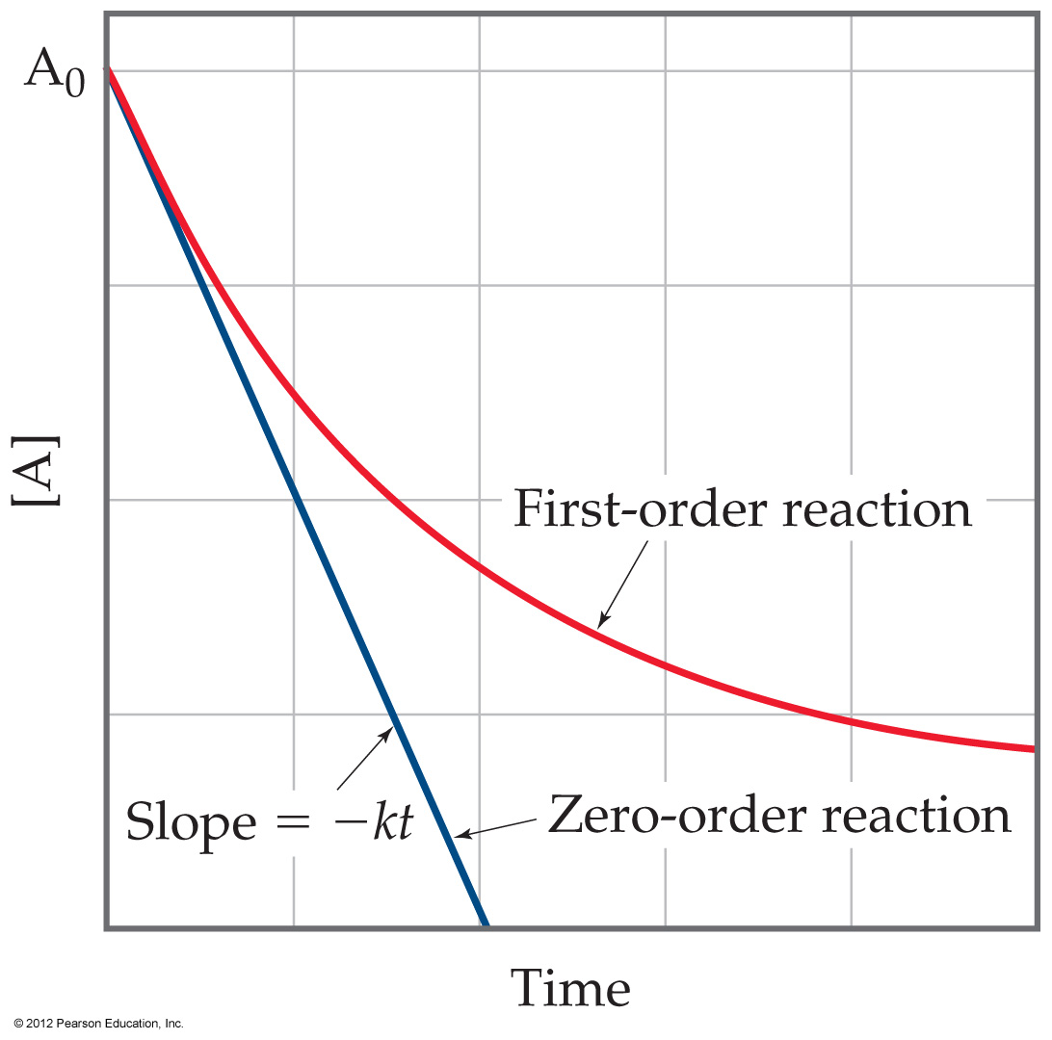
Notes:
Figure 14.10 Comparison of firstorder and zero-order reactions for the disappearance of reactant A with time.

Slide 33
 | Zero | First | Second
Rate Law | Rate = K[A]⁰ | Rate = K[A]¹ | Rate = K[A]²
Integrated Rate Law | [A] = -kt + [A]₀ | Ln[A] = -kt +ln[A]₀ | 1 = kt + 1 [A] [A]₀
Line | [A] vs t | ln[A] vs t | 1 vs t [A]
Slope = | - k | - k | k
Half-life | t_{1/2} = [A]₀ 2k | t_{1/2} = 0.693 k | T_{1/2} = 1 k[A]₀

Slide 34
Given the Reaction
2C₄H₆ → C₈H₁₂
And the data
[C₄H₆] mol/L Time (± 1 s)
0.01000 0
0.00625 1000
0.00476 1800
0.00370 2800
0.00313 3600
0.00270 4400
0.00241 5200
0.00208 6200

Slide 35
2C₄H₆ → C₈H₁₂

Slide 36
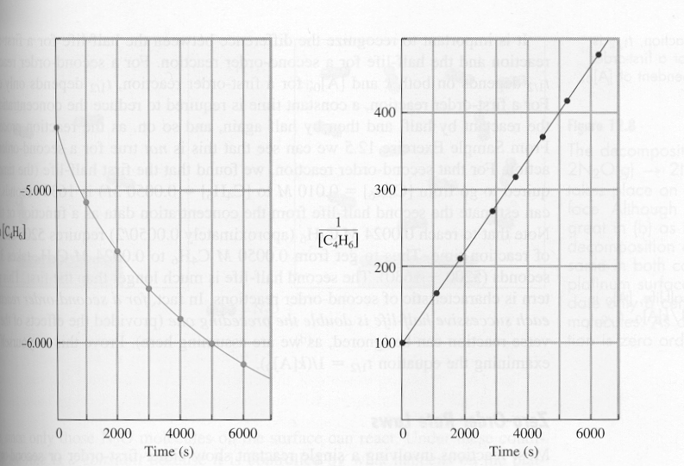
Graphical Analysis
___1___
[C₄H₆]
Ln [C₄H₆]

Slide 37
Experimental Derivation of Reaction Order
Arrange data in the form
  1/[A] or ln [A] or [A]
Plot the data vs time
Choose the straight line
y = mx + b
Determine the k value from the slope
Graphical rate laws
1/[A] = kt + b → 2nd
ln[A] = kt + b → 1st
[A] = kt + b → zero

Slide 38
Half-life
The time it takes 1/2 of the reactant to be consumed
This can be determined
  Graphically
  Calculate from the integrated rate law

Slide 39
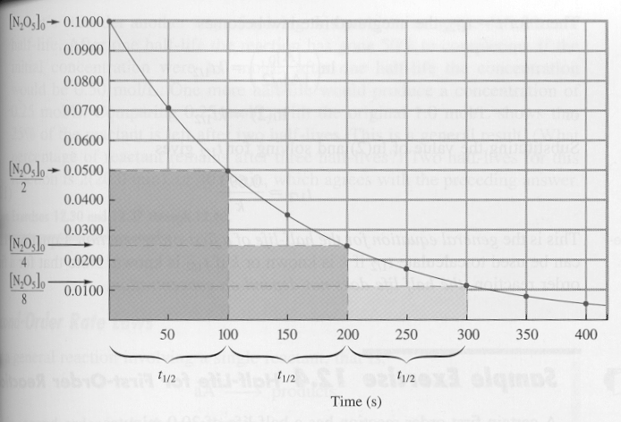
Half-Life
Graphical Determination

Slide 40
Half-Life
Algebraic Determination
 | Zero | First | Second
Half-life | t_{1/2} = [A]₀ 2k | t_{1/2} = 0.693 k | T_{1/2} = 1 k[A]₀
Equations are derived from the Integrated Rate Laws.

