Slide 1
Reactions Follow-up

Slide 2
Synthesis Reactions
Find an example of each type in your packet -
a. metal + nonmetal → binary salt
b. metal + oxygen → metal oxide
c. nonmetal + oxygen → nonmetal oxide
d. metal oxide + nonmetal oxide → ternary salt
e. metal oxide + water → base
f. nonmetal oxide + water → oxyacid
g. ammonia + acid → ammonium salt

Slide 3
Decomposition
binary salt or binary oxide → elements
metal carbonates → metal oxide + carbon dioxide
c. metal hydrogen carbonates → metal oxide + carbon dioxide + water
d. metal hydroxide → metal oxide + water
e. oxyacids → nonmetal oxide + water
f. metal chlorates → salt + oxygen

Slide 4
Write and balance net-ionic equations
(a) Solid potassium chlorate is strongly heated.
(b) Lithium metal is strongly heated in nitrogen gas.
(c) A solution of ethanoic (acetic) acid is added to a solution of barium hydroxide.
(d) A solution of copper(II) sulfate is spilled onto a sheet of freshly polished aluminum metal.
(e) Zinc metal is placed in a solution of copper(II) sulfate.
(f) Magnesium ribbon is burned in oxygen.
(g) A solution of nickel(II) bromide is added to a solution of potassium hydroxide.
(h) Hexane is combusted in air.

Slide 5
Answers
(a) KClO₃ → KCl + O₂
(b) Li + N₂ → Li₃N
(c) CH₃COOH+ OH– → CH₃COO– + H₂O
(d) Al + Cu₂⁺ → Cu + Al³⁺
(e) Zn + Cu²⁺ → Cu + Zn²⁺
(f) Mg + O₂ → MgO
(g) Ni²⁺ + OH– → Ni(OH)₂
(h) C₆H₁₄ + O₂ → CO₂ + H₂O

Slide 6
Titrations
We will cover two types of titrations in this course.
Acid-Base
Redox
In both cases the process is the same.
Take a solution of known concentration and add it to a known volume of a solution of unknown concentration.
Wait for a color change to determine when the solution is neutralized.
Use Stoichiometry to figure out unknown concentration.

Slide 7
Calculate
What was the concentration of 12.8mL of a Sulfuric acid solution if it was neutralized by 15.8mL of a 0.26M NaOH solution?
H₂SO₄ + 2NaOH → Na₂SO₄ + 2H₂O
15.8mL x .26mmol NaOH x 1 mmol H₂SO₄ x 1
1mL NaOH 2 mmol NaOH 12.8mL
= 0.16M H₂SO₄ solution

Slide 8
Memory Devices
Oxidation or Reduction???
LEO the lion goes GER
Lose Electrons Oxidation
Gain Electrons Reduction
OIL RIG
Oxidation Is Loss
Reduction Is Gain

Slide 9
Advanced Redox
Cu + HNO₃ → Cu(NO₃)₂ + H₂O + NO
Step 1 - Write the net ionic equation with the oxidation numbers.
Step 2 - Break equation apart into half-reactions.
Step 3 - Change coefficients to balance elements other than oxygen or hydrogen
Step 4 - Balance oxygen by adding H₂O
Step 5 - Balance hydrogen by adding H⁺
Step 6 – (only if in a basic solution) Add one OH⁻ to both sides of the equation for each H⁺, then cancel waters out.

Slide 10
You try!
Fe_{(s)} + HCl_{(aq)} → HFeCl_{4 (aq)} + H₂ _{(g)}
Acid Solution
Answer is
8H⁺ + 8Cl⁻ + 2Fe → 2HFeCl₄ + 3H₂

Slide 11
One More
PO₃⁻³_{(aq)} + MnO₄⁻_{(aq)} → PO₄³⁻_{(aq)} + MnO_{2 (s)}
Basic Solution
Answer
H₂O + 2MnO₄⁻ + 3PO₃⁻³ → 3PO₄³⁻ + 2MnO₂ + 2OH⁻

Slide 12
What does all this do?
Reactions can occur in one place, or the two half reactions could be separated into separate cells.
If the cells are connected by a conductor, then a current will flow allowing the electrons to move and the reaction to occur.
A voltaic or galvanic cell is one where this happens spontaneously to generate electricity.
An electrolytic cell needs electrical energy to drive a reaction that would not occur on its own.

Slide 13
Parts of the cell
The places where the electrons are exchanged are called the electrodes and they are dipped into electrolytes.
The electrode where reduction takes place is the cathode.
The electrode where oxidation takes place is the anode.
A salt-bridge or porous membrane must be used to separate the cells but still allow ions to migrate.

Slide 14
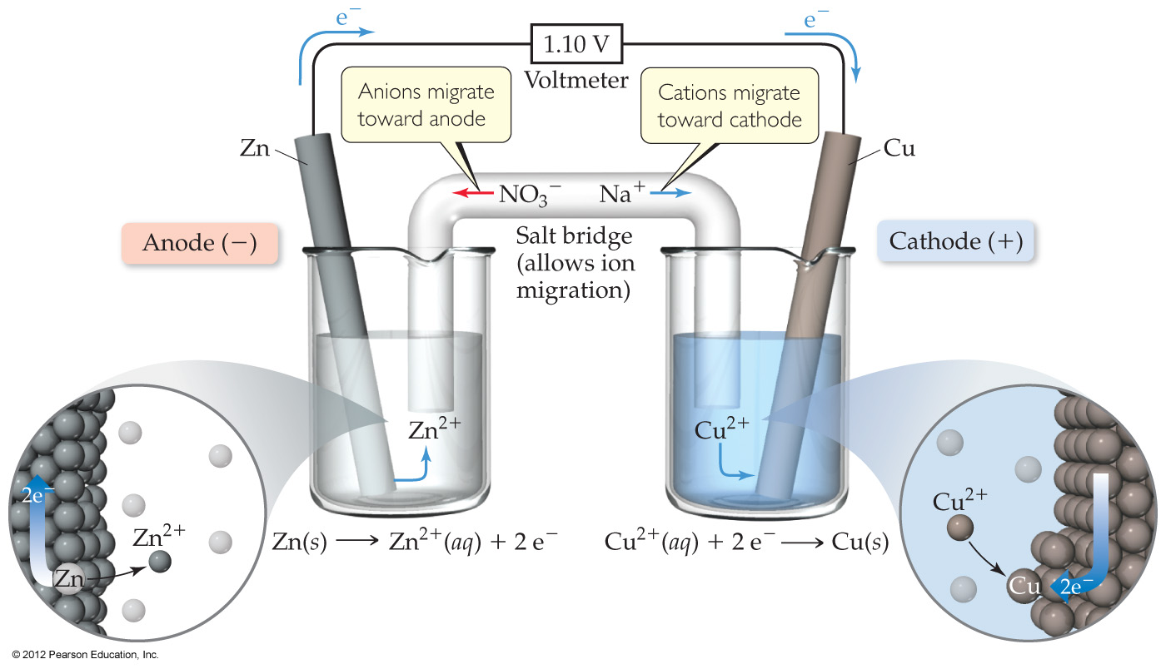
Notes:
Figure 20.5 A voltaic cell that uses a salt bridge to complete the electrical circuit.

