Slide 1
Hair Analysis

Slide 2
Uses
Most often in forensics, comparison tests are done to identify similarities with victims.
Other possible uses for hair is to do toxicology analysis.
Can find chemicals in hair that are not able to be found in blood and urine.
Poisons, drugs, environmental exposures.

Slide 3
Parts of the Hair
Part of the hair below the skin is called the follicle.
When that part is removed from the body it is called the bulb.
The shaft is the part that extends out from the skin.
Contains 3 parts.
The medulla – innermost unstructured region
The cortex – structural support of the hair and color
The cuticle – outside layer

Slide 4
Types of Hair
Vellus – type of hair that is all over the body and is light and unnoticeable.
Terminal – head hair
Androgenic terminal – hair that develops on other parts of the body during puberty.
Balding is terminal hair turning to vellus.

Slide 5
Hair growth
There are 3 steps to the hair growth cycle.
Anagen –growth phase – lasts up to 8 years – 85% of hair on the head is in this stage.
Catagen – transition – lasts 2 weeks – follicle detaches from shaft and pushes up.
Telegen – resting phase – lasts 1-4 months. No change. 15% of hair on head in this phase.
When the cycle restarts in the anagen phase, the old shaft is pushed out and causes normal shedding.

Slide 6
Hair color
Color is created by two pigments, both are types of melanin.
Most common is eumelanin which can be brown or black.
Lots of brown eumelanin will be brown hair, a little brown is blond hair.
Lots of black melanin is black hair, a low amount will be gray hair.
Other type is pheomelanin which results in red hair.
White or gray hair is a lack of melanin.
Hair follicles can have more than one type, and a person can have a mix.

Slide 8
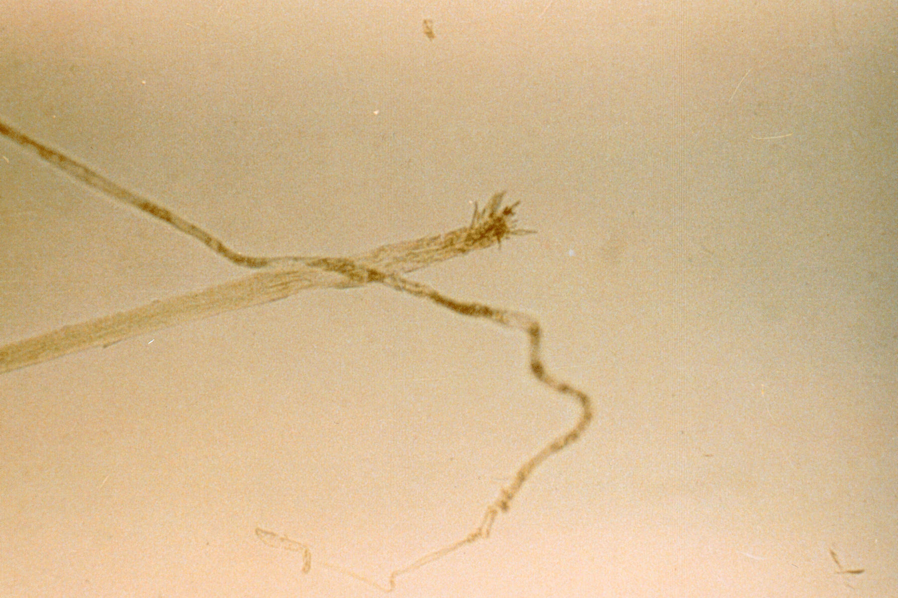
1
Hair root from a cat. Usually frayed
Notes:
This slide shows the hair root of a cat. The frayed end is characteristic of a cat root.

Slide 9
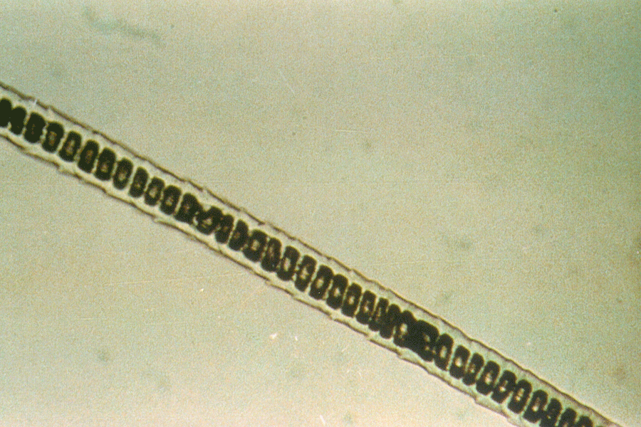
2
Uniserial or ladder-like medulla in cat hair
Notes:
The uniserial or ladder-like medulla in this slide is also that of a cat.

Slide 10
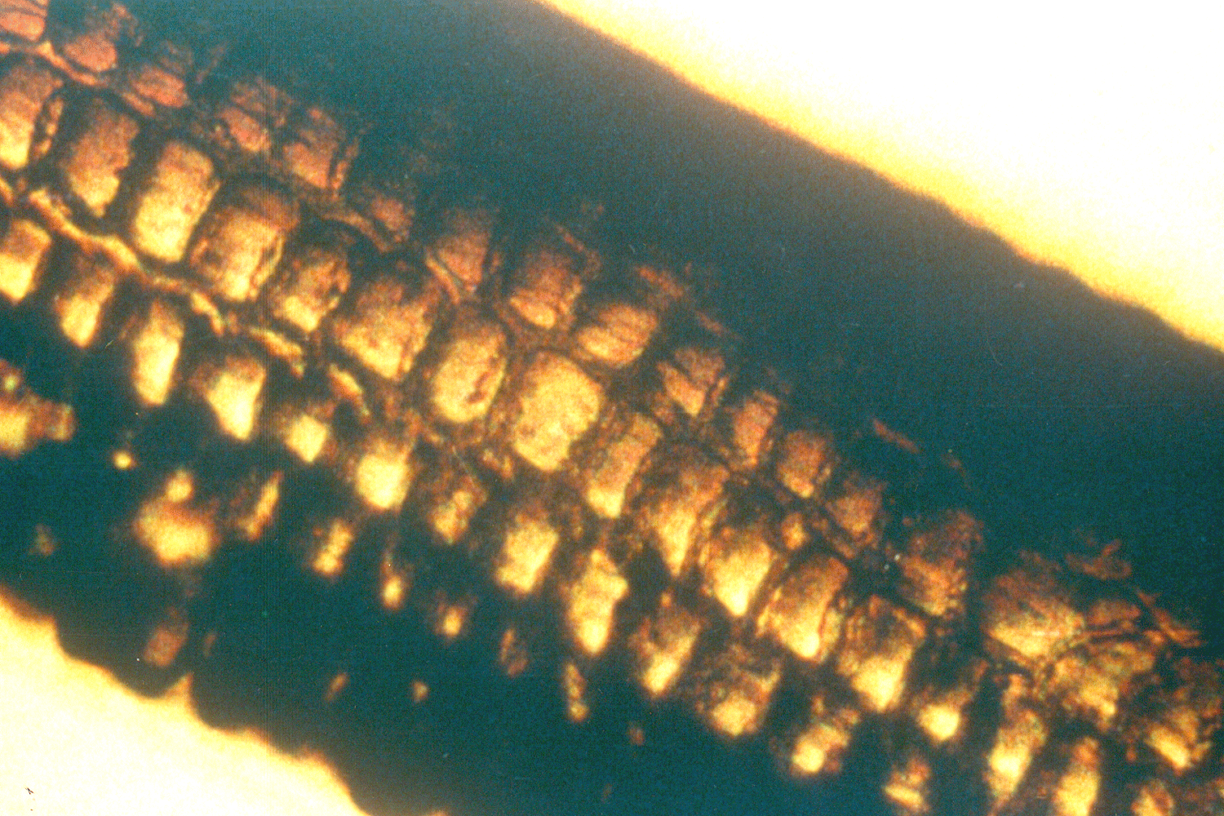
Multiserial medulla from rabbit hair
3
Notes:
This multiserial medulla, composed of many ladders, is characteristic of hair from a rabbit.

Slide 11
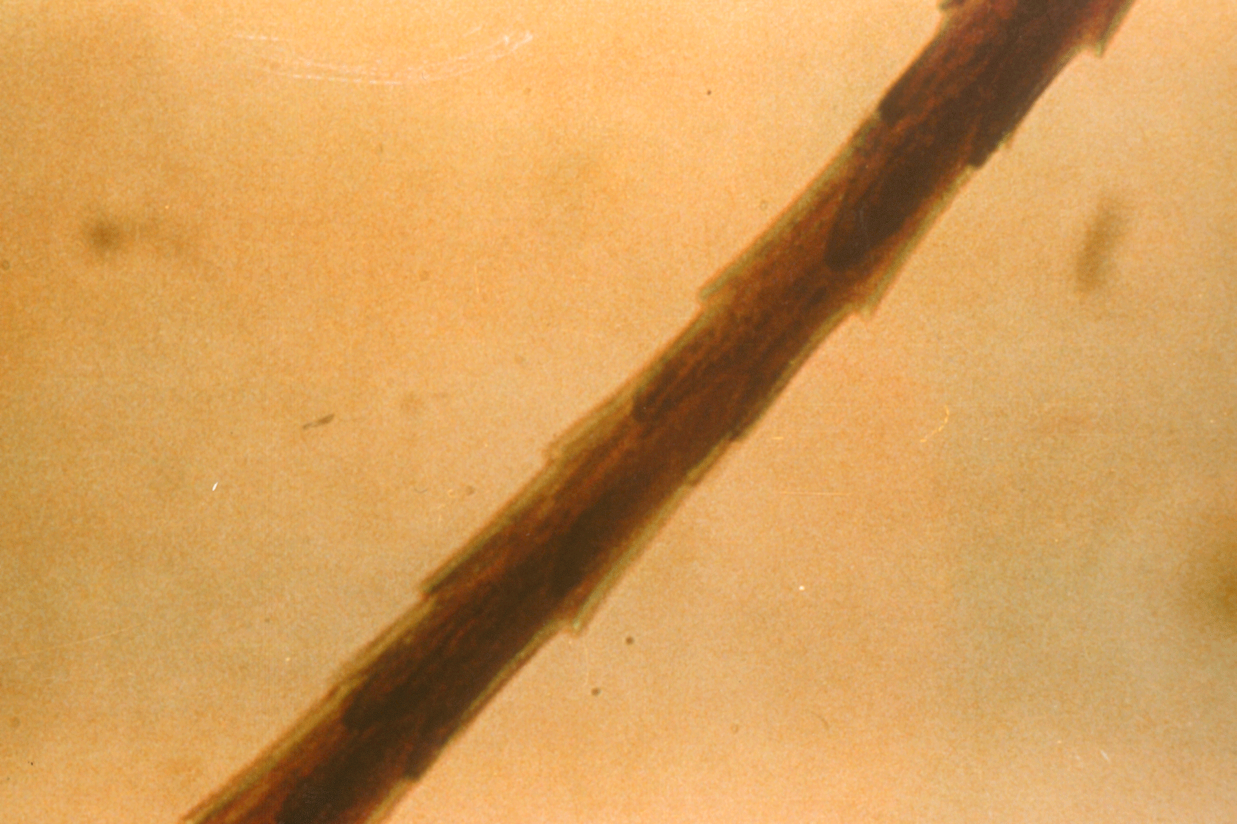
4
Spinous scale pattern of seal hair
Notes:
The spinous scale pattern of seal hair is easily observable without preparing a scale cast.

Slide 12
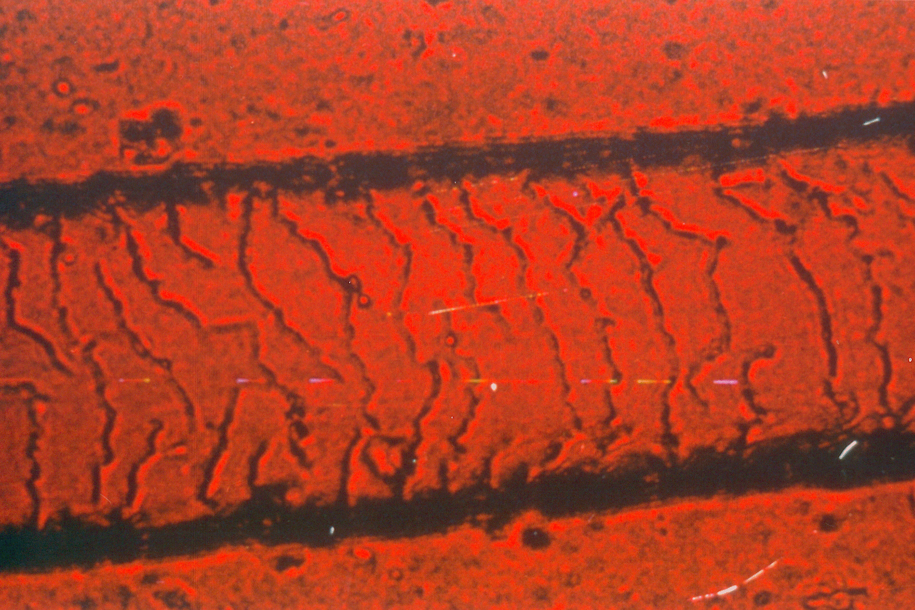
5
Human hair. Scale not easy to see without casting
Notes:
The human scale pattern is not as easily observable without preparing a scale cast.

Slide 13
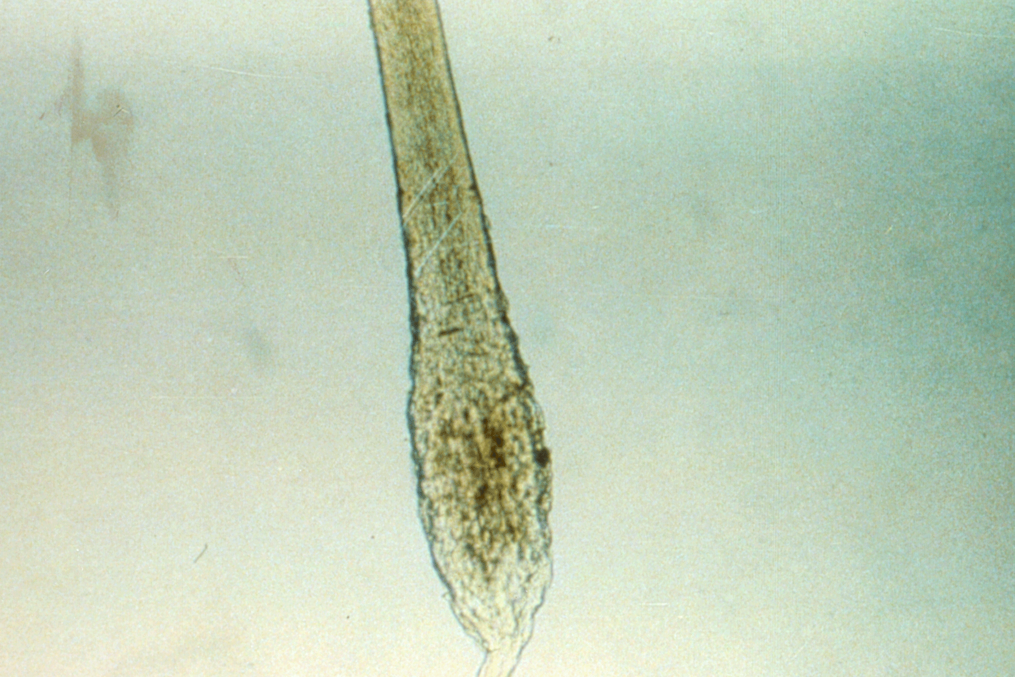
6
Human root. Club shaped root is characteristic of dead or dying root in telogenic stage
Notes:
This club-shaped human root is characteristic of dead or dying root in telogenic stage.

Slide 14
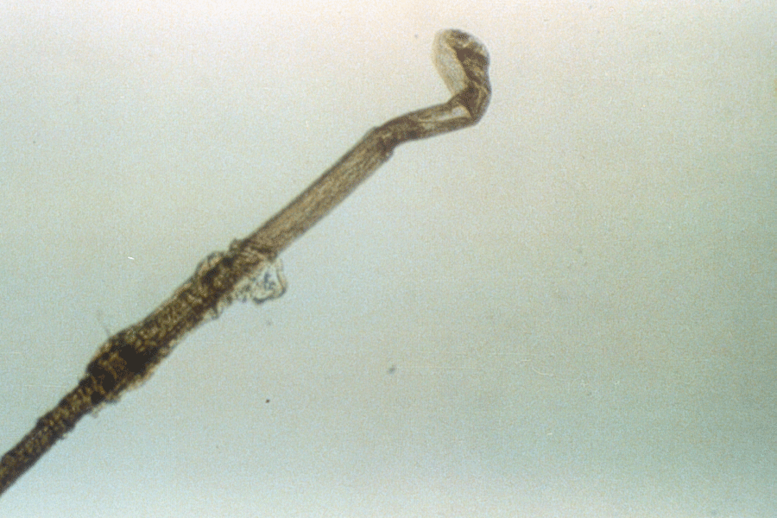
7
Forcibly removed human hair. Follicle is still attached
Notes:
A human hair that has been forcibly removed will have a root that looks like this. Part of the follicle will be attached.

Slide 15
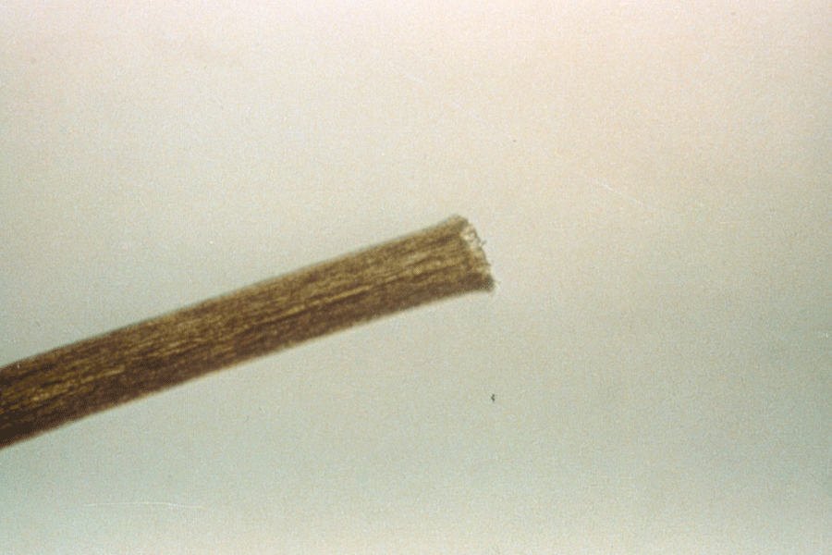
8
Freshly cut human hair.
Notes:
A hair that has been freshly cut with a scissors will look like this. Notice the ragged edge and sharp corners.

Slide 16
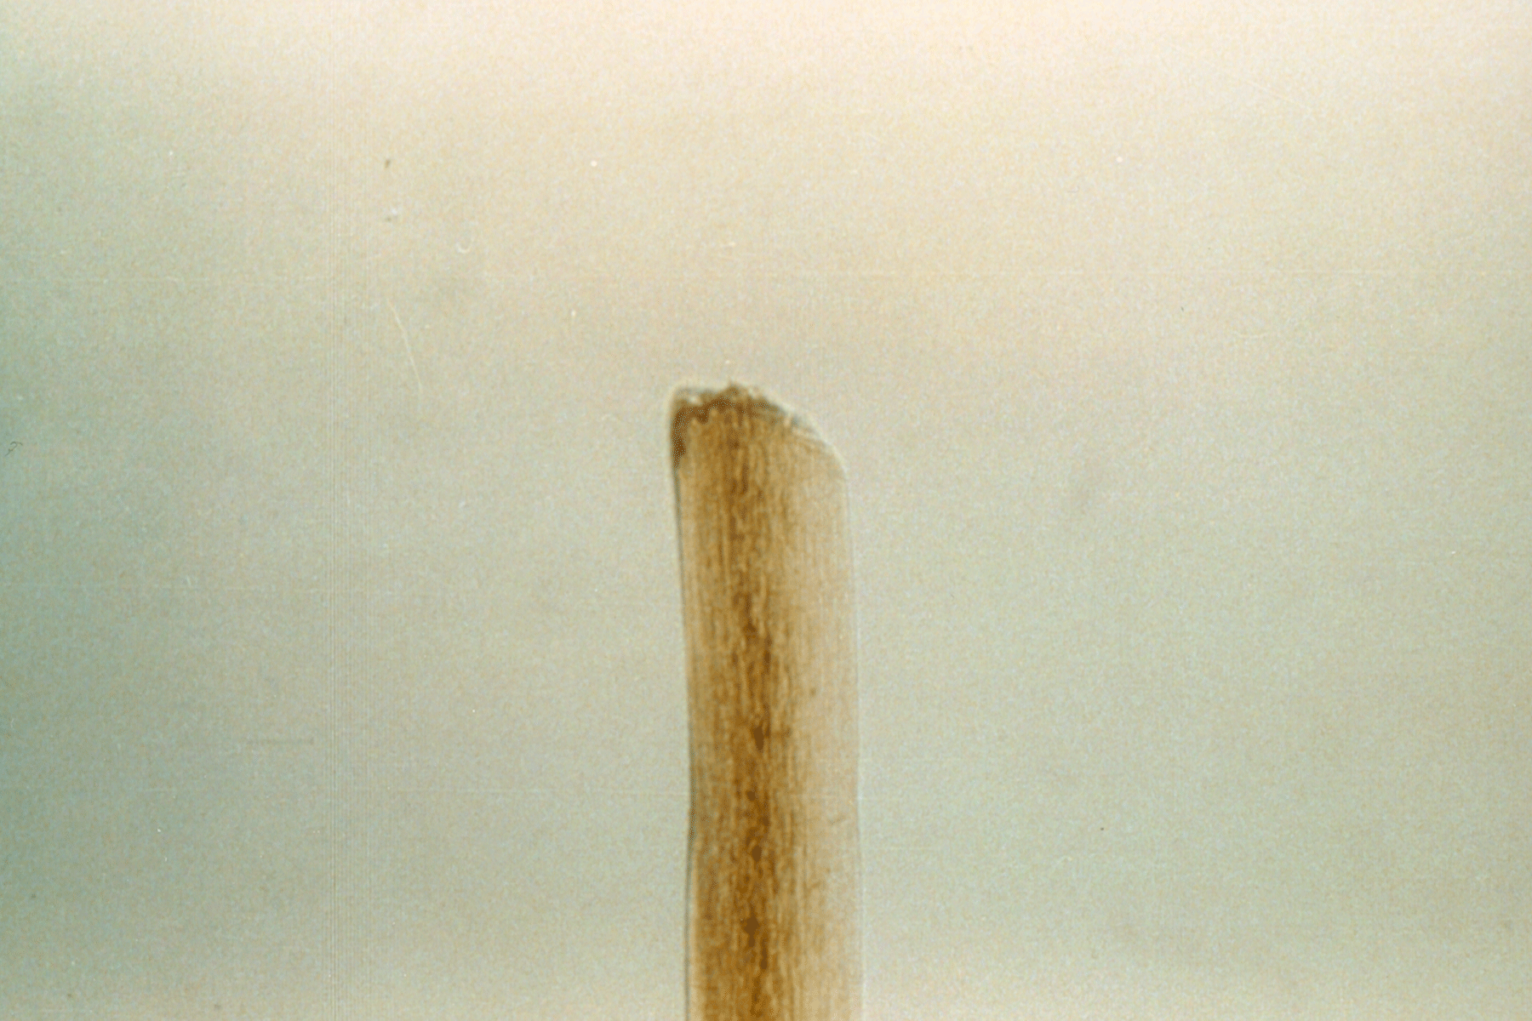
9
Rounded edge means hair has not been freshly cut
Notes:
A hair with rounded corners indicates that the hair has not been freshly cut.

Slide 17
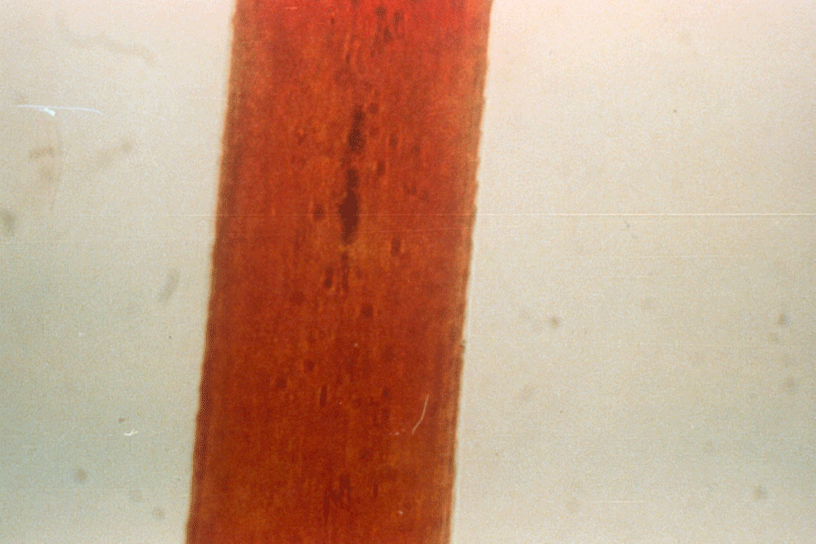
10
Dyed hair. Can be obvious since the color is even across the whole hair.
Notes:
This hair has been dyed. Notice the even color distribution cross section of the hair.

Slide 18
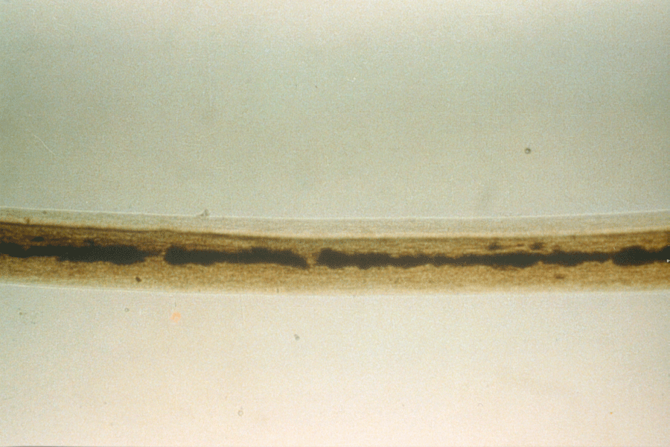
11
Notes:
The demarcation line is observable on the same hair between the dyed and undyed portions. The length of the undyed segment can be used to determine how long ago the hair was dyed.

Slide 19
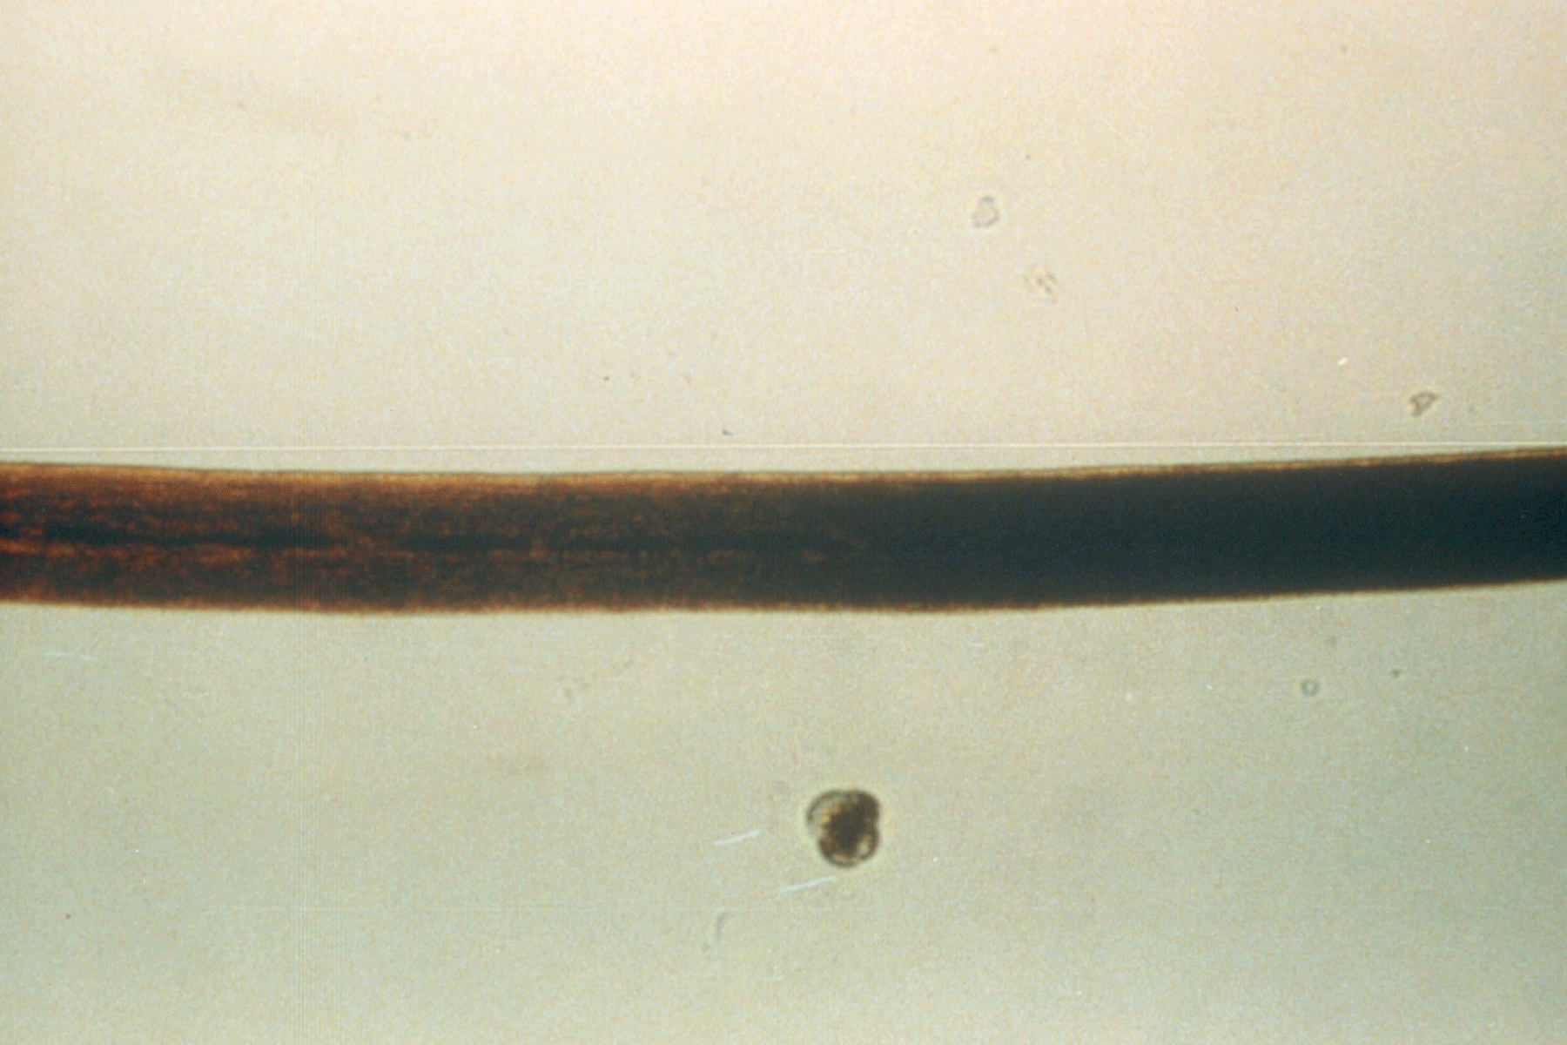
12
Some hairs have different shapes, so they are mounted longitudinally. This has a kidney shape.
Notes:
Some hairs are not round, but kidney shaped in cross section. The overlapping can be deduced from a longitudinal mount, as shown in this slide.

Slide 20
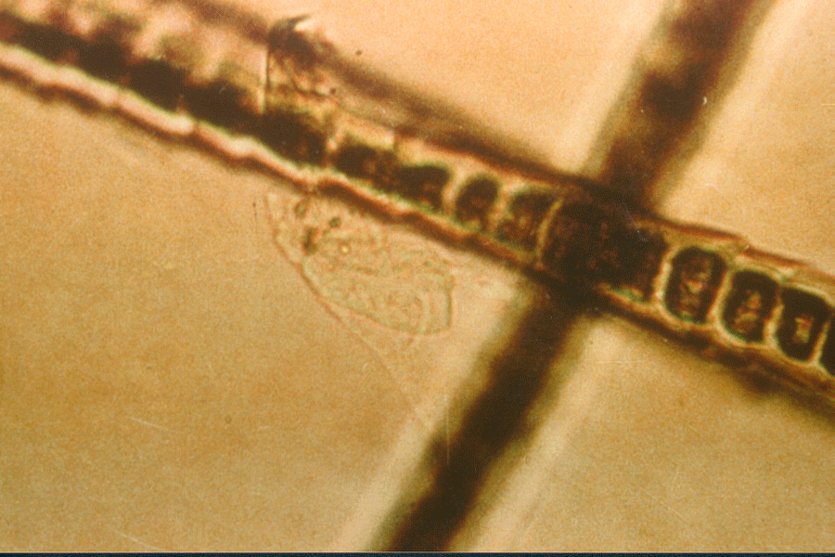
13
Lice on a hair. Eewwww!
Notes:
External environment also can play a role in hair examinations. This picture reveals the outline of a louse.

Slide 21
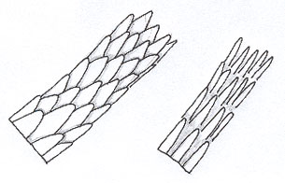
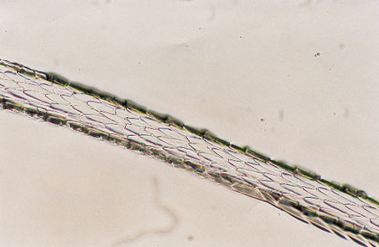
Spinous or petal like scales found on mink, seals, and cats. Never human.
14
Notes:
Spinous or petal-like scales are triangular in shape and protrude from the hair shaft. They are found at the proximal region of mink hairs and on the fur hairs of seals, cats, and some other animals. They are never found in human hairs. Figure 6 is a diagram of spinous scales, and Figure 7 is a photomicrograph of the proximal scale pattern in mink hairs.

Slide 22
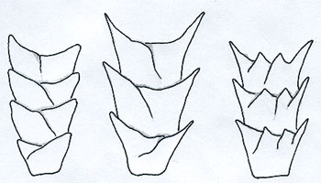
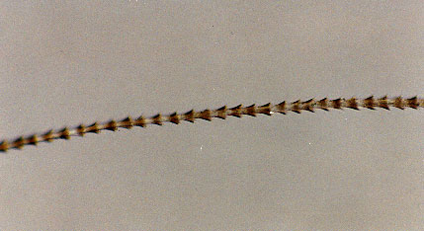
15
Coronol or crown like patter are found on rodents and bats. Rarely human.
Notes:
The coronal, or crown-like scale pattern is found in hairs of very fine diameter and resemble a stack of paper cups. Coronal scales are commonly found in the hairs of small rodents and bats but rarely in human hairs. Figure 4 is a diagram depicting a longitudinal view of coronal scales, and Figure 5 is a photomicrograph of a free-tailed bat hair.

Slide 23
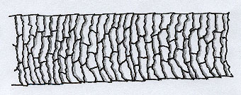
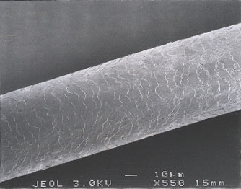
16
Imbricate or flattened scales common to human hairs.
Notes:
The imbricate or flattened scales type consists of overlapping scales with narrow margins. They are commonly found in human hairs and many animal hairs. Figure 8 is a diagram of imbricate scales, and Figure 9 is a photomicrograph of the scale pattern in human hairs.

Slide 24
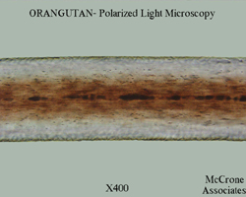
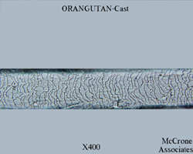
17
Similar to human
Orangutan (Pongo pygmaeus)

